Slide 1
Advancing Process Safety
4Q 2012 Process Safety Metrics Webinar
Changing Corporate Culture
Kelly K. Keim – Chief Process Safety Engineer

Slide 2
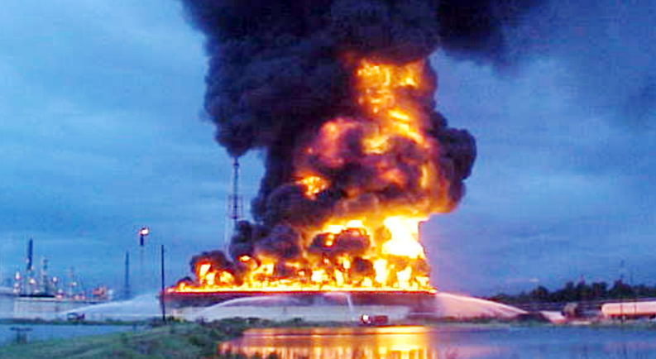
The CEO
Phossel Fuels Petroleum: Fictional Company
The CEO: Henry Phossel
Triggering Event
Henry Phossel
Notes:
Phossel Fuels is a fictional petroleum and petrochemical company.
It was founded by Henry Phossel and three roughnecks that he worked with in North Texas with a single drilling rig carried in the back of a truck. After drilling three dry holes they hit their first gusher just as Henry was beginning to consider giving up. From that point on, Henry re-invested heavily in his company expanding over time to ownership of refining and petrochemical operations. One thing Henry never forgot about was the people that made his company possible. He prided himself on how his employees were treated and the benefits they received, including excellence in safety performance.
But lately Henry has been a bit distracted, what with his second divorce and his third marriage so he hasn’t been so attuned to what has been happening in the Energy Industry.
Then came the fire. It occurred on the largest crude tank that Phossel Fuels had ever built, over 250 ft. in diameter This tank had just been filled for the first time with over half a million barrels of crude. Within the final foot of the safe filling range the floating roof hit a snag and began to tip releasing crude above the floating roof. The crude ignited, eventually burning across the entire surface of the tank and burned for 36 hours before it was extinguished. No one was hurt in the fire or the response to it, but the CSB decided to investigate because the fire was on one of the nations largest above ground tanks. The CSB Chairman vowed to determine if there was an inherently safer option than storing so much crude in one place.

Slide 3
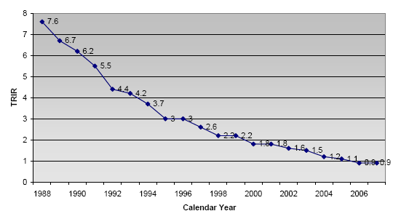
The Press Conference
After the CSB announces that it will investigate the tank fire at Phossel Fuels Gumbo Lake refinery Henry holds a press conference extolling Phossel’s focus on safety and environmental responsiveness.
Phossel Fuel’s Personnel Safety Performance
Notes:
Henry presented the chart below as proof of Phossel’s focus on improving safety performance.
He was surprised when he was ridiculed for pointing to a history of Personnel Safety performance as being relevant to Process Safety performance and could not respond when asked by the press about 2 other fires and three releases that had occurred at the Gumbo Lake refinery in recent months. He was not aware of those events or what steps had been taken to prevent their recurrence.
Henry isn’t quite sure what reporters and Labor representatives are referring to when they refer to Process Safety. To Henry, safety is safety.

Slide 4
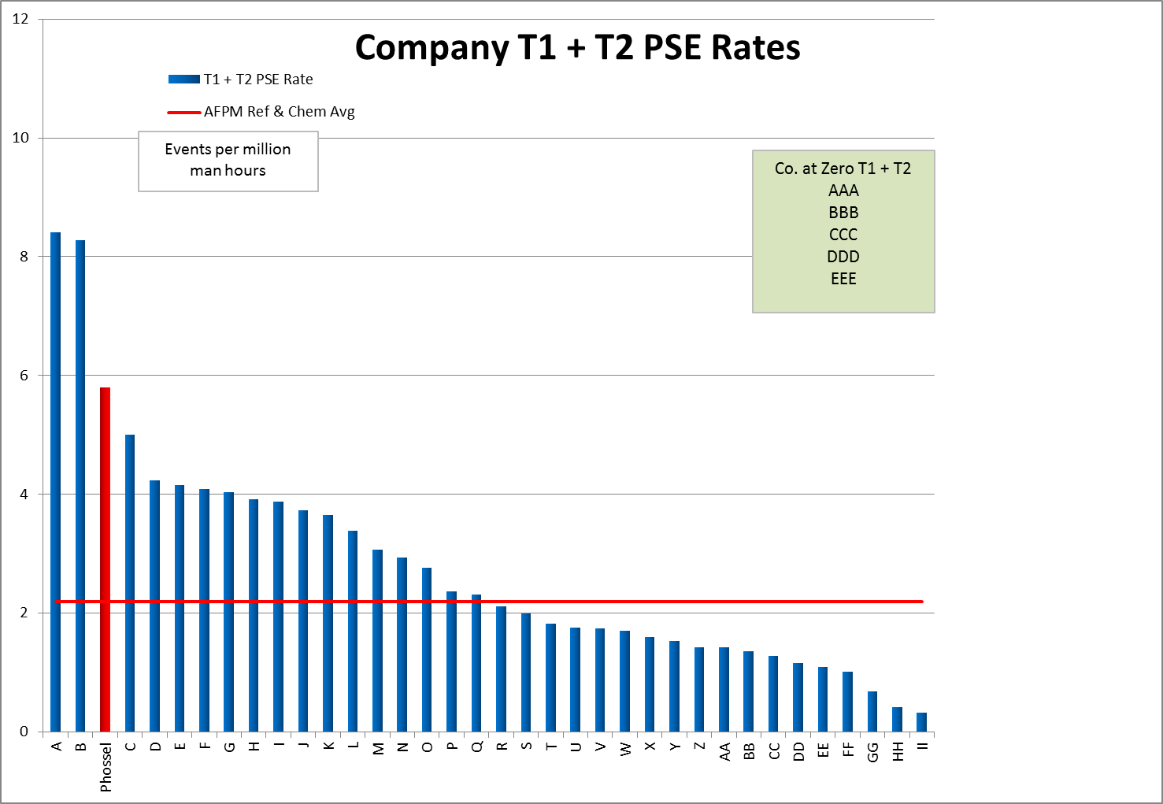
Executive Committee Meeting
Henry Learns the Meaning of Process Safety
The prevention of harm to people, the environment and property caused by the release of material from a process.
Process Safety focuses on the prevention of Low Frequency High Consequence events.
Henry wants to know how Phossel compares to its peers.
Notes:
At the Phossel Executive Committee meeting the next day the first topic of business is the preliminary report from the tank fire investigation committee and what steps must be taken immediately to ensure other tanks do not suffer a similar fate.
Then Henry asks his executives what the press is referring to when they talk about Process Safety. They aren’t quite sure and none of them believe they are responsible for it so they invite Frank Lees, the Manager of Loss Prevention in the Process Division, into the meeting for the first time.
Frank educates the committee on the meaning of Process Safety.
Henry wants to know how Phossel compares to its peers in Process Safety.
Frank has been capturing Process Safety Tier 1 and 2 events since seeing the API 754 standard for Process Safety Indicators posted on the API website. Henry is taken aback when he finds that Phossel is deep in the fourth quartile of his peers in the refining and petrochemical industry and that Phossel’s rate of these events is more than double the industry average.
Henry is suspicious of the data on the chart especially since he sees that workforce hours are used to normalize for company size. Frank explains that many potential normalizers have been examined and they all result in nearly identical seriatims and since workforce hours is readily available in all companies, it was chosen as the normalizer.
Henry asks how it is possible that Phossel can have Personnel Injury performance better than most and yet be so poor in Process Safety.

Slide 5
Harm to People may be rare in Process Safety Events
Phossel’s Tier 1 + 2 Events by consequence type
Notes:
Frank shows Henry that less than 5% of Phossel’s Process Safety Events result in injury to personnel. Many of the 95+% of Tier 1 PSEs that didn’t result in an injury to personnel, however had the potential to have resulted in catastrophic damage. Only luck prevented those consequences in many cases. Furthermore, often it is only luck that separates a Tier 2 PSE from being a Tier 1 PSE.
Henry is a proud and competitive man. He vows that Phossel will do better and become a leader in Process Safety with performance among the best in the industry.
He asks Frank how they can start.
Frank suggests that for starters, each Tier 1 PSE be reviewed by the Operations Management Committee so that lessons can be learned and shared rapidly across all sites. Henry asks how many Tier 1s there will be and Frank responds that there are typically one per month. Frank says that isn’t enough and he wants the OMC to review all Tier 1s and 2s so that they share on average a couple each week.
Henry asks Frank to sit in these OMC reviews to ensure that the proper lessons are learned and shared. Frank is stunned, he has never been asked to spend time with the executives before. Frank knows that this will be a great opportunity to get the executives on board. He will have Henry as an ally in gaining increased attention paid to the large number of spills and releases that occur and don’t hurt people or catch on fire but could have.
The Executive Committee and the OMC see Henry visiting Frank often and see Henry spending an increasing amount of time on Process Safety. They know that Henry spends time on the things that are important to him and to Phossel.

Slide 6
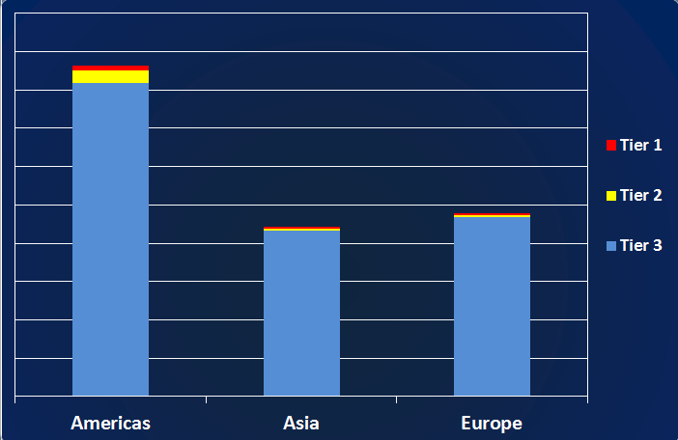
Operations Management Committee
Begin by reviewing one-page summaries of Tier 1 + 2 PSEs.
Challenge to become more proactive
Notes:
The OMC begins reviewing one-page summaries of Tier 1 + 2 PSEs. These provide a brief description of what happened, but more importantly, why it happened. Henry often sits in for these reviews. He is supportive of Frank when he challenges the Site Manager that the investigation hasn’t gone deep enough and an investigation has only determined what happened and not why it happened. Eventually the Global Operations Executive (GOE) and site managers (a competitive group) begin to challenge each other on the depth of these investigations and the effectiveness of recommendations made for prevention. Each site manager knows that he will receive the worst type of attention if his site has an incident due to the same causal factors as one his peer has already reported having addressed. It will appear that he has not applied a lesson learned. The OMC becomes very responsive to these Tier 1 + 2 events. The GOE feels good about being responsive but also recognizes that they are mostly being reactive vs. proactive. He challenges Frank to help them become more proactive.
Frank has been preparing for this opportunity.
He shows them slides of some data he has been preparing.
Frank shows the OMC that for every Tier 1 or 2 event that they are reviewing there are 30 to 100 Tier 3 PSEs that occur. These Tier 3s represent an even greater opportunity for learning at an even faster pace. The OMC is stunned to learn that all these events are occurring and want to learn more about what constitutes a Tier 3 PSE.

Slide 7
Phossel’s Tier 3 PSEs
Non-LOPC (Loss of Primary Containment) Fires in Process Areas
Safe Operating Limit Excursions
Demands on Safety Systems
Releases less than Tier 2 PSE threshold
The Loss Prevention Manager explains why it is not meaningful to compare rates of Tier 3 PSEs across Phossel’s sites as a measure of Process Safety performance.
Each site should, however examine each Tier 3 PSE in a manner similar to the way the OMC reviews Phossel’s Tier 1 + 2s.
Notes:
Frank shows the OMC that according to the API 754 guidance, Tier 3s consist of fires in process areas that did not result from LOPC, Safe Operating Limit Excursions, Demands on Safety Systems and other releases that were below the Tier 2 threshold. The GOE ask to see a normalized breakdown by site so they can determine which sites need the most help. Frank explains to him that the sites are of differing ages, complexity, types of process and level of automation as well as size. There is no meaningful way to compare site to site PSE rates, but that within a site Tier 3 rates can be used to track changes in performance, and even more importantly, each provides an opportunity to learn how to prevent others. The GOE asks Frank to show him how.
Frank shows the GOE some data on SOLEs from the Gumbo Lake site. First, Frank advises the executive that the relatively high number of SOLEs indicates that Gumbo Lake has a good reporting culture, which is to be praised. But then Frank asks the executive to look at the details of those SOLEs. At first he notices that one tag # appears several times. It is a high level alarm on a tank. Frank informs the executive that there is no trip to shut off the flow to this tank on high level. Frank has investigated this recurrence and found that the level instrument normally used by the operators has been in disrepair for some time so operators have begun filling the tank until they receive the alarm each time. Then the GOE notices that many of the SOLEs are tank level alarms and Frank confirms that tank level devices are not being maintained. The Gumbo Lake site has accepted that tanks are filled until the level alarm sounds and then the operator makes the swing. This guarantees that overfills will occasionally happen.

Slide 8
Notes:
Phossel’s Tier 3 PSEs (cont’d)
The GOE sees that he has an opportunity to change the Process Safety culture at Gumbo Lake, but doesn’t want to come down from headquarters to hammer the site manager, who has shown promise as an effective leader. Frank tells the GOE that he has already shared this issue with the site manager and he is busy addressing it, but that he also has budget concerns. The GOE assures Frank that they will have the budget to address important maintenance needs. Frank tells the GOE that the CSB is also likely to find this causal factor in relation to the tank fire. The GOE says he can’t change the past but he sure wants to learn from it.
The GOE asks Frank to work with the leadership teams at each site to help them learn to examine their Tier 3 PSEs to identify similar opportunities for improvement. Frank spends the afternoon scheduling his visits and making travel arrangements.
By looking for patterns in the Tier 3 data at each site, Frank is able to identify Pressure Relief Valves and Safety Instrumented Systems that have been challenged multiple times. He shows the sites that each time one of these events happens they should look at their database of events to see if it has occurred in the past. Several Process Managers are surprised that these events receive this level of scrutiny. Their initial attitude is one of, “That’s what relief valves and trip systems are supposed to do.” Frank shows them that these devices and systems have about a 1% failure rate and that if the devices and systems are challenged more than once every 10 years the consequences of failure will occur much more often than Phossel Fuel’s risk acceptance criteria would permit.

Slide 9
Examination of Tier 3 De Minimis Releases
Point of Release | # of Releases | % of Releases
Piping Systems | 65 | 39%
Pumps | 19 | 11%
Atmospheric tanks | 19 | 11%
Other | 15 | 9%
Furnace | 13 | 8%
Flare / Relief System | 7 | 4%
Pressure Vessels | 6 | 4%
Further examination of the piping system releases showed that 30% of them occurred due to Corrosion Under Insulation in sweating or cyclic-sweating service.
Piping inspection practices were probability-based but failures occurred randomly in these services.
Cycles of stripping insulation, inspect and repair were not reducing the frequency of these releases over time.
Notes:
At a site where De Minimis releases dominated the Tier 3 PSE reporting Frank prepared a breakdown of the locations where the release occurred. Piping systems dominated as points of release. As Frank discussed this data with the site Leadership Team the Maintenance Manager supported the accuracy of the data, however he further added that a significant fraction of these small releases were due to Corrosion Under Insulation (CUI) and that in his experience CUI only resulted in small releases. Frank pulled up company-wide data that showed almost 1% of the CUI releases resulted in ruptures with much larger releases occurring. A more seasoned (more gray hair) member of the LT remembered an incident from the past where this had happened at the site. The Maintenance Manager pointed out that they had been stripping insulation, inspecting, repairing and re-painting the piping for years but that in sweating services leaks from CUI seemed to occur randomly and the inspect and repair cycle had to be repeated every 5 to 7 years. Frank asked why a partial inspection technique was being applied to a failure that occurred randomly. “That’s a good question.” was the only response.
Frank reported that a technique called Thermal Sprayed Aluminum was being used on piping in CUI service with excellent results to provide a protective coating. TSA appears to provide 30+ years of protection vs. even excellent paint systems that may last as few as 5 years in cyclic-sweating service. Application of this technique eventually moved the site out of a revolving cycle of repairing leaks on a random basis. Application of TSA spread rapidly to all of Phossel’s sites because despite a higher initial installation cost it was clear that TSA was a money-saver over the life of the facilities.
You can see that Lagging Indicators can be very useful when used properly to identify trends and vulnerabilities beyond the equipment or facility that experienced the event contrary to the CSB’s frequent description of their use being like driving down the road looking out the rear view mirror.

Slide 10
Safety Management System Indicators
Process Hazards Analysis Completed on Time
Process Safety Action Item Closure
Training Completed on Schedule
Procedures Current and Accurate
Work Permit Compliance
Mechanical Integrity Inspection completed on Time
Closure of repair notices on Safety Critical Equipment
Management of Change compliance
Pre-Startup Safety Review compliance
Completion of Emergency Response drills on time
Fatigue Risk Management – Percent overtime
Notes:
A few of Phossel’s US sites discussed their Process Safety Management systems required by OSHA’s 1910.119 regulation and the lack of information that these systems provided regarding their effectiveness. They asked Frank to provide guidance on indicators that they should use. Frank naturally went back to API 754 and found that the suggested Tier 4 indicators would work quite well for Phossel, including its international locations.
An intern good with spreadsheets and displays created a template that all sites could use to display these metrics for their internal Leadership Teams to review monthly and for the GOE to review with them on his quarterly visits. By this time, the GOE was already aware of the reasons that it made little sense to try to roll these metrics into a global report. He did ask which of these systems’ failures contributed most to Phossel’s significant incidents. Frank reported that Phossel’s incident investigation system and tracking database had been modified a year ago so the data was available.

Slide 11
Management System Linkages
Since management is responsible for all systems, it underlies all incidents
33% of the analysed incidents had a linkage to Operating Procedures
82% were linked to Failure to Follow Procedures
11% were linked to inaccurate or out of date procedures
7% were linked to an absence of procedures
17% of the analysed incidents had a linkage to Management of Change
A large fraction of these were due to less than adequate technical review of the change
LTA occurred more frequently at smaller sites than at larger sites
11% of the analysed incidents had a link to response to alarms
18% of the analysed incidents had a link to either Energy Isolation of Opening Process Equipment
Management, Leadership & Supervision
Notes:
This pie chart shows a breakdown of how Process Safety events linked to management systems in place at Phossel. Frank pointed out that the management system for Management, Leadership and Supervision was ultimately responsible for all incidents as this system was responsible for the implementation and effectiveness of all other systems, hence it is the crust that holds the rest of the pie together.
The largest slice of the pie was devoted to Operating Procedures, with most of those associated with a failure to follow procedures. The GOE requested that this issue be the primary Process Safety topic at his global site manager’s conference in two weeks.
The site managers were not surprised by the dominance in failure to follow procedures. Frank asked the managers if they expected their operators to follow procedures. They thought it an odd question. Of course they did. Frank asked them to show him where and how they had communicated this expectation. That left the managers stunned as they couldn’t point to a specific communication in this regard. He also asked them what they meant when they said they expected operators to follow procedures. He received answers such as, “I just expect them to do it right,” and “They were trained on the procedures (many years ago, but that’s beside the point.)” Frank asked why operators didn’t print the procedures out and check the steps off one-by-one as they were accomplished. One manager said that they could never run the plant that way. Frank asked that manager, “Why do you expected an operator to go perform a task that he rarely does and that has the potential for serious consequences and not expect him to have that procedure in his hands?” A team was immediately formed to create a company standard for how procedures would be used. Some would be designated Safety Critical and would be required to be used in Checklist fashion with each step initialed by the person completing it. That hard copy would be included in shift change meetings by operators and first lines. The expectation would be clear that the operator was expected to have that procedure with him in the field. A system was set up with expectations for each leadership level to verify procedure use in the field on a prescribed frequency. The leaders would ask to see the procedure and discuss each step with the operator as it was executed. In this discussion they could reinforce their expectations and appreciation for adherence to procedures.

Slide 12
Notes:
Management System Linkages (cont’d)
The “Alarms” category was dominated by less than adequate response to alarms with a few failures of alarms. There was some overlap in the Alarm category and the absent or out-of-date procedures categories. Frank asked console operators what actions they took when they received certain high priority console alarms. The responses differed from operator to operator. Only a few pointed to procedures for the designated response. One enterprising operator reported that he had memorized the first few steps of each alarm procedure so that he know what to do while he called up the procedure itself for reference. Frank worked with each site until they had established accurate procedures to be used in response to each high-priority console alarm. Then he worked with the site emergency response coordinator to establish drills to test response to these alarms so that each team drilled on each alarm at least once per year. Initially the emergency response coordinator saw his role as limited to firefighting, HAZMAT and emergency medical response teams and not Operations teams. Frank explained that appropriate Operations response in the first few minutes of any event had a dramatic effect on the level of emergency that response teams dealt with when they arrived and that this might, in fact be the most crucial part of a site’s emergency response effectiveness.
Frank went on to work with those sites where less than adequate technical review of Management of Change had contributed to events. He found that the reviewer for each Process or Engineering discipline reviewed the change package by him or herself at the computer. Frank visited one site that rarely had a problem with MOCs. He found that they performed the technical review in groups that brought all disciplines together. This allowed experienced members to challenge issues outside their assigned discipline, but in which they had some previous experience. This proved extremely useful in educating the less experienced members of the team so that issues were less likely to be missed by a junior member carrying out the review on their own. Frank worked with the OMC to establish this work process at all sites.

Slide 13
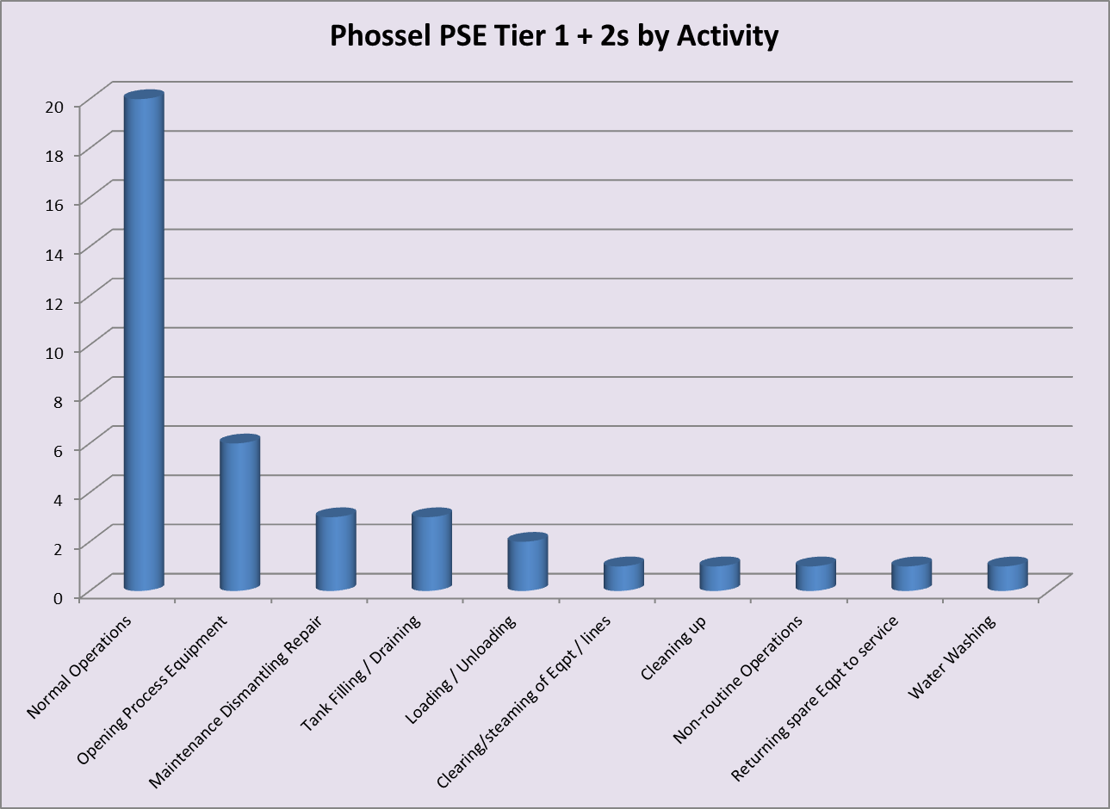
Analysis by Work Activity
Analysis of Work Activity linked to Tier 1 + 2 PSEs highlights the Human Performance element in Process Safety events.
Since other initiatives are addressing PSEs in “Normal Operations,” Phossel takes on the challenge to do better at Opening Process Equipment
Notes:
Frank has seen the model showing that Process Safety brings together the realms of Facilities or Equipment, Systems which we’ve called Management Systems, and Human Performance. As he looks at the initiatives that Phossel has begun he sees several associated with equipment (Safety Critical level instrumentation and Thermal Sprayed Aluminum for piping in sweating service), several associated with Management Systems (Procedures, Alarm Response, and Management of Change) and while each of those involves employees at some level, none of them are targeted specifically at Human Performance. An obvious opening is to look at the activity linked to each Tier 1 + 2 PSE. Most are linked to “Normal Operations” for which Phossel already has targeted initiatives. Opening Process Equipment (OPE) leads all other activities, so Frank takes on the challenge to do better at OPE. Phossel has clearly stated Best Practices for OPE so he reads the detailed investigation reports linked to this activity. He finds that operators simply did not execute according to expectations detailed in the OPE. He also finds that in some cases the operator was faced with a challenge such as a leaking valve that he hadn’t dealt with before. Frank knows that according to the Hawthorne Effect, people will change their behavior simply due to knowing that their performance is being monitored. But in addition to this, he knows that by getting supervisors and other leaders into the field to check OPE activity they have an increased opportunity to communicate their expectations, but also to ensure that sufficient knowledge and experience are brought to bear when circumstances are not as planned during job preparation. This reinforces the message that it is ok to shut any job down if it cannot be completed safely, particularly when circumstances have changed from the plan prepared before the work had begun. Senior leaders observations of junior supervisors and managers during these field observations helps them identify those ready to advance to more responsible positions.
Moreover, the experience shows Frank that he does not need a number of incidents meeting mathematical definitions of “statistically significant” to identify and act on opportunities to improve.

Slide 14
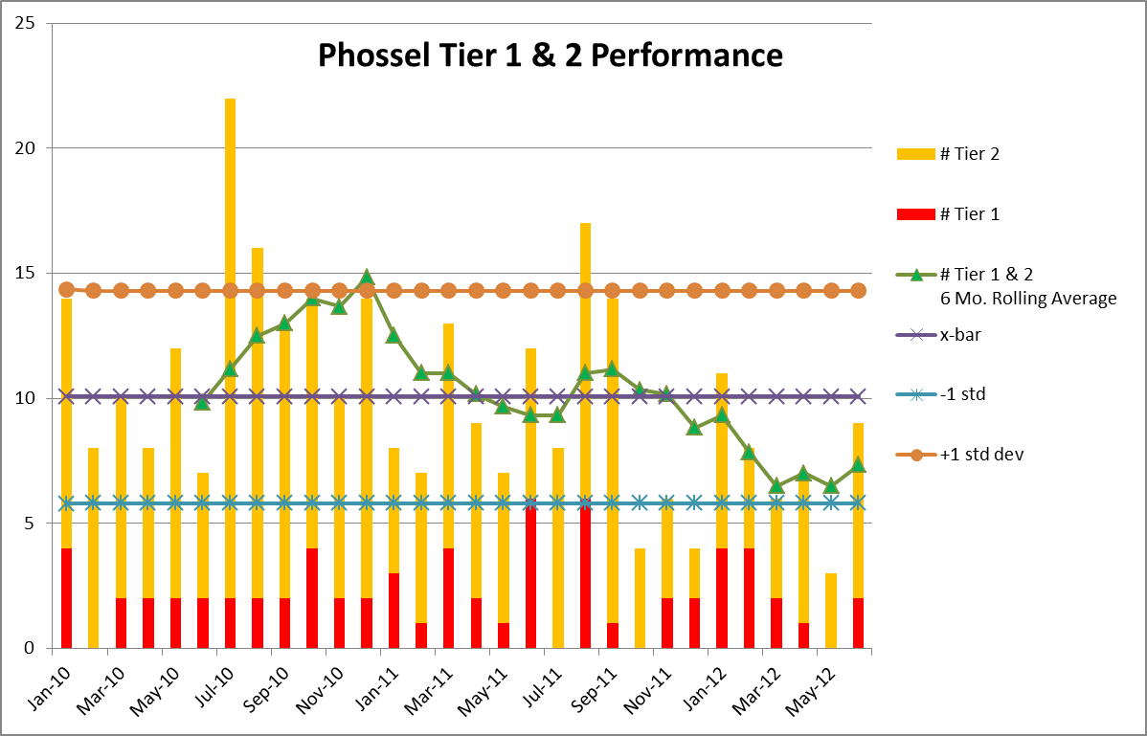
Phossel Tracks its Performance
Notes:
Phossel’s Executive Committee remains very engaged in improving their process safety performance. Frank provides this slide which tracks their performance on a monthly basis. He explains to them that Tier 1 PSEs represent the lagging metric of events that they are working to eliminate, however on a month to month basis the number is too small to detect real changes in performance. Therefore he displays Phossel’s combined Tier 1 + 2 performance since as a group they are focused on a leading indication of their Process Safety performance.
In addition to the columns that represent the Tier 1 in red and the Tier 2 in gold each month, Frank provides horizontal lines for x-bar (the average for the period in view) and x-bar plus and minus one standard deviation of the total for Tier 1 + Tier 2. Frank reminds the executives that 68% of the monthly results should fall between the extremes so they do not over-respond to the natural variation from month to month. Undue despair at a poor monthly showing is as inappropriate as unduly celebrating a good monthly result.
After he has accumulated enough monthly data, Frank incorporates a six month rolling average onto the chart. There is nothing magical about a six month rolling average, but it smoothes out the month to month variation. That six month rolling average appears to demonstrate that Phossel is making a performance improvement. Frank intends to change the line to a 12 month rolling average when he has sufficient data points to justify it.

Slide 15
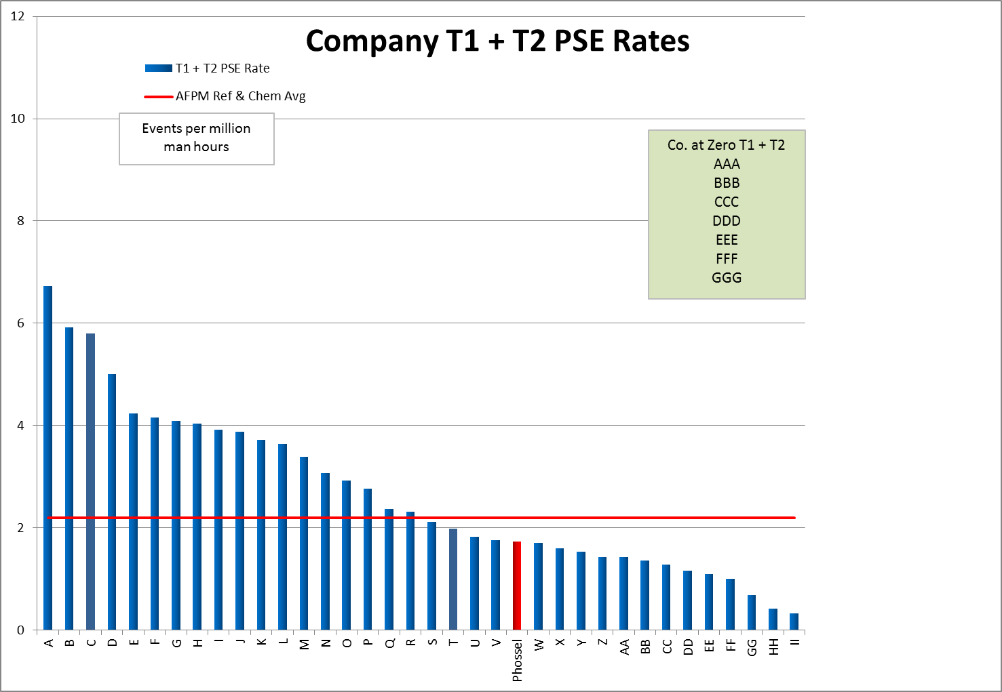
Phossel’s Performance Improves
2 Years after the Gumbo Lake fire:
Phossel’s Tier 1 + 2 PSE rate is better than the industry average, which also improved
When the CSB completes its report on the Gumbo Lake fire, Phossel embraces it and has already addressed its recommendations
After an invited visit to tour the Gumbo Lake site the CSB Chairman reports that Phossel “Gets it.”
Phossel’s performance relative to peers 2 years after Gumbo Lake fire
Notes:
Two years after the Gumbo Lake tank fire, Phossel has made a dramatic improvement in their Tier 1 and 2 Process Safety Event performance. Not all companies can effect change as rapidly as Phossel. They had several factors going for them. First, they had an engaged and committed chief executive who was able to quickly motivate and inspire his management team to focus on Process Safety. The management team made use of a workforce that was already engaged in Personnel Safety and simply needed the tools with which to focus on Process Safety. They also had Frank Lees who had prepared himself and was ready with data at all tiers to drive Phossel’s improvement efforts.
When the CSB held its public hearing to release its report on the Gumbo Lake tank fire, Phossel embraced the report and had already addressed its recommendations. They invited the CSB Chairman to visit the site and talk with its personnel. At the public hearing the CSB Chairman reported that “Phossel Fuels gets it!”
As for Frank, he was invited to the next meeting of the Phossel Executive Committee. He was stunned as he was ushered to a new chair at the conference room table with a brass plaque on the back just like all others, but with “Frank Lees, Process Safety Executive” engraved in it.

Slide 16
Questions

