Slide 1
API Joint Board of Directors/
Annual Membership Meeting
2013

Slide 2
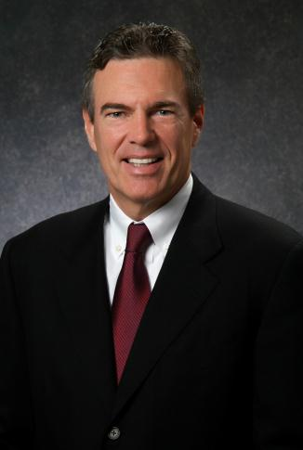
THE
AMERICAN PETROLEUM INSTITUTE
GOLD MEDAL FOR DISTINGUISHED ACHIEVEMENT
IS HEREBY AWARDED TO
James T. Hackett
Partner, Riverstone Partners, LLC
Notes:
Communications supports on the ground efforts.

