Slide 1
Biovapor Model; Models and Exclusion Criteria
in:
Workshop 7: Recent Developments in the Evaluation of Vapor Intrusion at Petroleum Release Sites
March 24, 2015, 6:30pm – 9:30pm
at:
25nd Annual International Conference on Soil, Water, Energy, and Air
Mission Valley Marriott San Diego, California
March 23 - 26, 2014
George DeVaull
george.devaull@shell.com
Notes:
+ This section is a presentation on the BioVapor model, which was specifically developed for petroleum vapor intrusion estimates.

Slide 2
Workshop Agenda
Welcome, Introductions, Safety Issues
Update on ITRC VI Workgroup
Update on EPA OUST
BioVapor and other models; and Introduction to Exclusion Criteria
Evaluating the Vapor Intrusion Pathway - Studies
Sampling and Analysis
Case Studies/ Lessons
Summary
30 minutes

Slide 3
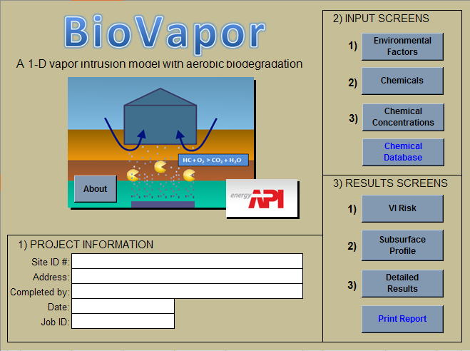
BioVapor Model
To Be Covered:
Model Introduction
Application Examples
Notes:
+ The talk includes:
+ A brief introduction and overview.
+ Several applied examples of the model use.
+ It does not include details of the model theory (which you can find in the model documentation)
+ And does not include running case examples.

Slide 4
J&E Model: Subsurface Vapors to Indoor Air Vapor Intrusion
Johnson and Ettinger (1991): Heuristic model for predicting the intrusion rate of contaminant vapors into buildings, Environ. Sci. Tech., 25:1445-1452.
  Applied: ASTM E2081-00; E1739-95; USEPA, 2003; others
USEPA OSWER - Subsurface Vapor Intrusion Guidance (2002):
  “The draft guidance recommends certain conservative assumptions that may not be appropriate at a majority of the current 145,000 petroleum releases from USTs. As such, the draft guidance is unlikely to provide an appropriate mechanism for screening the vapor pathway at UST sites.”
Tillman, F.D. and J.W. Weaver, 2005, Review of recent research on vapor intrusion, EPA/600/R-05/106
  “While caution would require the evaluation of the soil-to-indoor air pathway for all subsurface contamination, there are, in fact, not many cases of proven vapor intrusion documented in the scientific literature. This is particularly true for organic vapors subject to aerobic biodegradation, such as gasoline compounds (petroleum hydrocarbons).

Slide 5
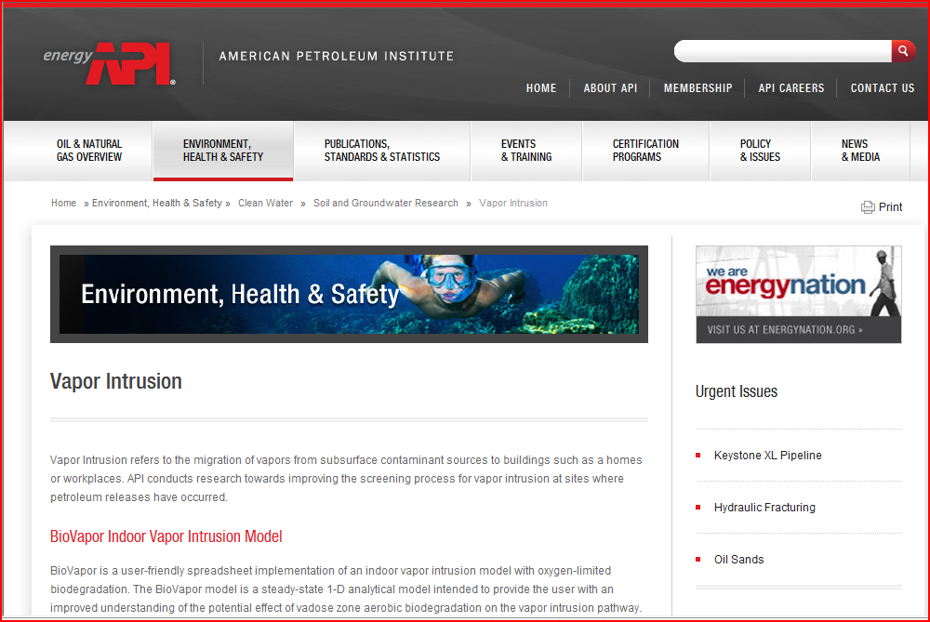
American Petroleum Institute BioVapor Model
Download at: www.api.org/pvi
OR Navigate www.api.org to
Environment, Health & Safety > Soil & Groundwater Research > Vapor Intrusion
Free, asks for registration information (update notification)
Questions (API): Roger Claff, claff@api.org, 202-682-8399;
Bruce Bauman, Bauman@api.org, 202-686-8345
Acknowledgements: Tom McHugh, Paul Newberry,
GSI Environmental, Houston.
Notes:
+ The BioVapor model is available from API. It’s a free download.
+ Registration is requested – for communication of updates and a download count.
+ If you have questions, talk to me or contact API staff.
+ And I acknowledge Tom McHugh and Paul Newberry of GSI who put together the software and user guide.
API website updated February 2012. Navigate www.api.org to
Environment, Health & Safety > Soil & Groundwater Research > Vapor Intrusion

Slide 6


BioVapor: Intended Application
yes
Improved understanding of Petroleum Vapor Intrusion
Calculate oxygen concentration / flux required to support aerobic biodegradation
Identify important model input parameters and output variables – and their sensitivity
Available, free
Predict hydrocarbon concentrations in indoor air within a factor of 10
  Site complexity
  Temporal variability
  Indoor background
no

Slide 7
Model Use Comparison
Many models are available … tradeoffs
Complex: numerical, multi-dimensions, time-dependent
  intensive computation, potentially few users
  Explore building / foundation interaction details
  Lateral building / foundation to source separation
  Can be ‘stiff’ (numerically unstable)
Simple: analytical, semi-analytical, one-dimension
  Very fast calculations
  Multiple chemicals, oxygen sinks, no problem
  Sensitivity estimates are realistically possible
  Insight into trends, sensitivity, key parameters
  Easily coded and run
    Yao and Suuberg, 2013: A Review of Vapor Intrusion Models, ES&T

Slide 8
API BioVapor: Use
Structure
  Menu-driven
  Microsoft Excel™ spreadsheet
    Open, unlocked, reference guidance
Input:
  Same or similar parameters as Johnson & Ettinger model
    Similar conceptual model & caveats on model applicability and use.
    Includes ‘oxygen-limited aerobic biodegradation’ (DeVaull, ES&T 2007)
  Additional Parameters and Information
    Either can be readily estimated, or
    Included in database (example: chemical-specific aerobic degradation rates)
Key:
Quantify the contribution of aerobic biodegradation
Available and relatively easy to use
Notes:
+ BioVapor is not the only model available, but the intent here was to have a model that was simple-to-use, run, and apply.
+ The model includes relatively simple defined input menus and output tables and plots.
+ If you want to check, the model is open and can be unlocked.
+ Parameters are same as for many implementations of the Johnson and Ettinger model, but the model includes oxygen limited chemical biodegradation.
+ So therefore there are a few more model parameters. These are either easy to estimate, or included in the model database (like degradation rates).

Slide 9
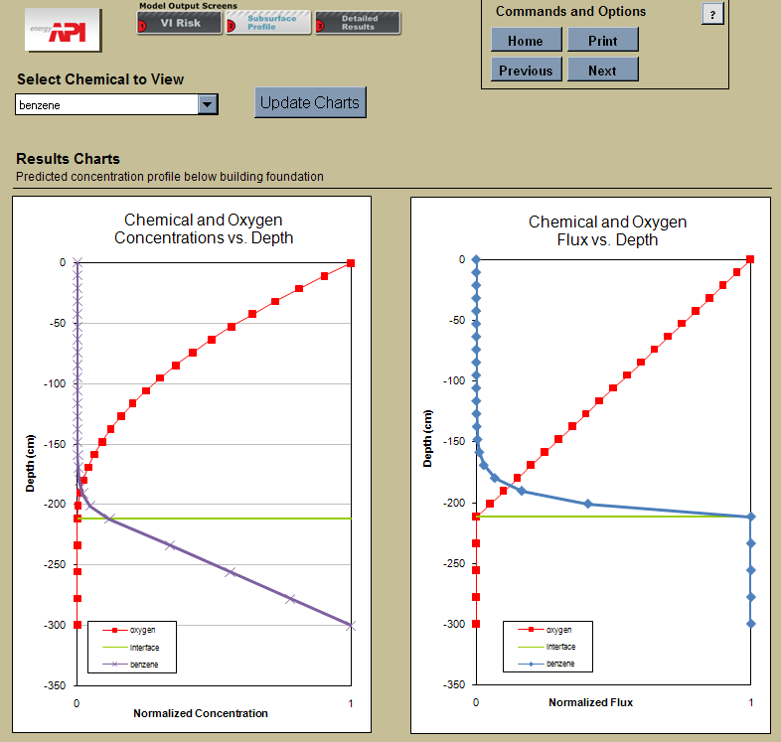
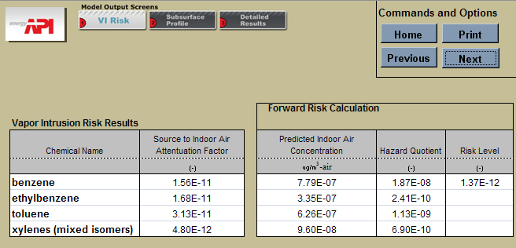
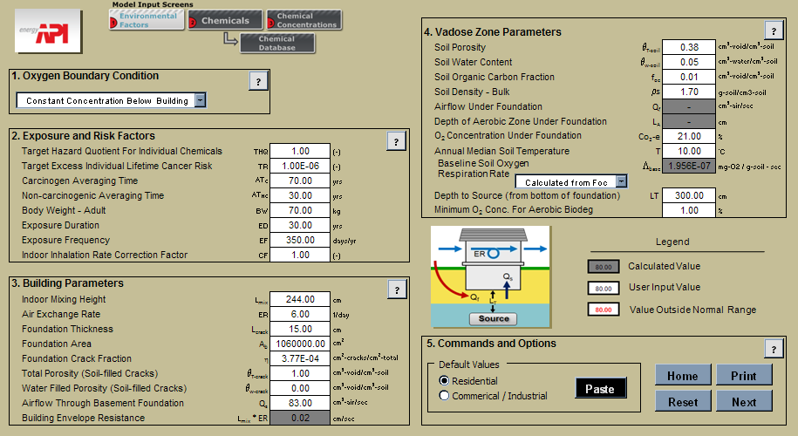
BioVapor: Menus & output

Slide 10
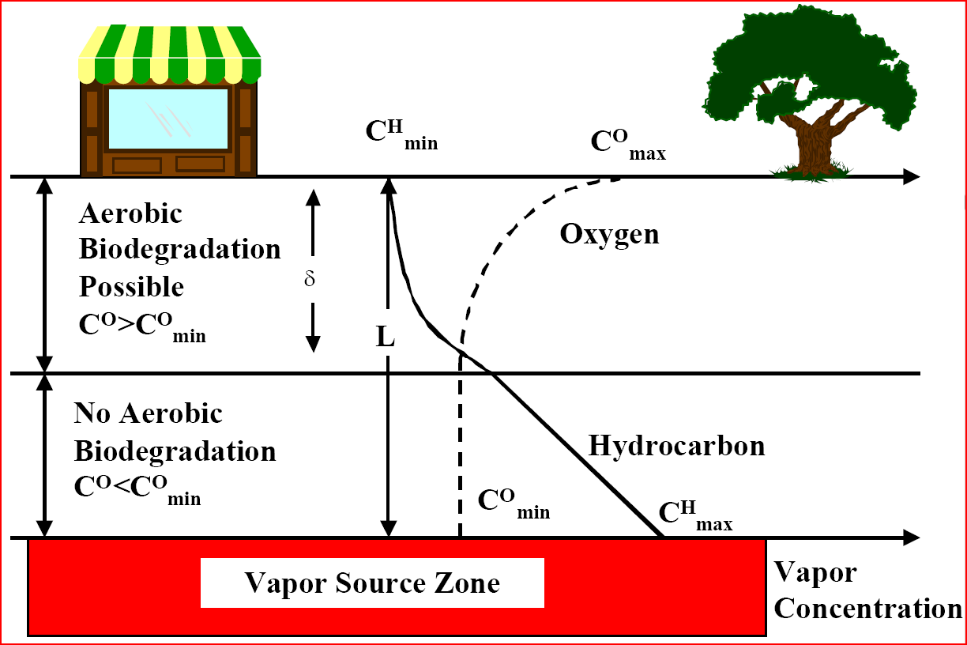
Petroleum Biodegradation Conceptual Model
Key Idea: oxygen consumption and
hydrocarbon attenuation are directly correlated
Notes:
+ The BioVapor conceptual model follows the diagram on the left.
+ It includes a building, a soil layer, and a petroleum vapor source at depth.
+ A shallow aerobic soil layer is included where degradation occurs. If oxygen is limited there is a deeper anaerobic layer where degradation is neglected.
+ The key idea there is that oxygen consumption is directly linked to petroleum biodegradation and attenuation.
+ I’ve included another conceptual model on the right, as a flow-resistance diagram. As in the other figure we have oxygen at the top and petroleum vapor at the bottom, and reaction of both in the middle. This diagram helps illustrate that the flow resistances – for oxygen and other gases, through the building, foundation, and soil, as well as petroleum vapors are substantially similar. So if we have resistance parameters for one chemical, we have or can estimate the parameters for any and all of the gasses or vapors.

Slide 11
Oxygen below Buildings: Basis
Aerobic Biodegradation
  Hydrocarbon to Oxygen use ratio: 1 : 3 (kg/kg)
  Atmospheric air (21% Oxygen; 275 g/m³ oxygen) provides the capacity to degrade 92 g/m³ hydrocarbon vapors (92,000,000 ug/m³)
Oxygen below a Foundation: can it get there?
  Through the foundation
    Equate to same transport parameters as other VI chemicals
  Around the foundation edges (bonus)
    Additional oxygen
Key: Oxygen below a foundation
Can oxygen get there?
Is there enough oxygen to support significant aerobic biodegradation?
Notes:
+ In aerobic biodegradation, disappearance of oxygen and hydrocarbons are proportionately related. On a mass basis, this is about a 1 to 3 ratio.
+ Using the concentration of oxygen in air, we can see that there is significant capacity for aerobic petroleum degradation. On a concentration basis, about 92 million micrograms per cubic meter.
+ The question in our conceptual model is whether oxygen can get below the foundation and into the soil.
+ It can go through the foundation (similar to chemical vapors, which move both ways), and it can also go around the edges of a foundation.
+ there are provisions in the model for including both, or conservatively neglecting the airflow around the foundation, either way.

Slide 12
Oxygen in the BioVapor Model
Three Options:
  Specify Aerobic depth
    Measure vapor profile
  Specify Oxygen concentration under a foundation
    Measure oxygen
  Let the model balance hydrocarbon & oxygen consumption
    Specify vapor source composition (gasoline vapor, etc.)
    Estimate or measure hydrocarbon source
Key:
Pick one method; the others are related (and predicted)
Relatively unique to this model (particularly #3)
Notes:
+ Now in the model, oxygen (or the contribution of degradation) can be specified three ways:
1) Directly specify the aerobic depth – comes from a measurement.
2) Specify oxygen concentration under a foundation.
or
3) Specify the source vapor concentration (either measured or conservatively estimated). Then the model estimates the oxygen consumption and the aerobic depth.
The third method is fairly novel. It means we can conservatively make these estimates based on existing data.
All three of the methods are related in a given scenario. If one oxygen value is specified, the other two are directly related and predicted.

Slide 13
Aerobic Petroleum Biodegradation Rates in Soil
Aromatic Hydrocarbons
k_{w} = 0.48 /hr (0.08 to 3.0)
k_{w} = 40 /hr (7.8 to 205)
Aliphatic Hydrocarbons
Chemical-Specific Rates
DeVaull, 2011: Biodegradation rates for petroleum hydrocarbons in aerobic soils: A summary of measured data, International Symposium on Bioremediation and Sustainable Environ. Technol., June 2011, Reno.
‘reaction length’
Notes:
+ Another part of the model is in estimating aerobic biodegradation rates in vadose zone soil.
+I am showing a figure from a recent presentation this summer at the Battelle conference of ‘first-order water phase degradation rates’ for a range of petroleum hydrocarbon chemicals. Based on field and laboratory measurements.
+ These values are consistent with what is in the BioVapor model and in the 2007 E&ST paper. Not exactly matching, but consistent.
+ What is shown gives us more granularity on the data – more chemical-specific rates, shows comparisons between different chemicals, and distributions of rates across a wide range of empirical data sets.
+ The last point on this slide is that the ‘first-order water phase rates’ are not applied directly, but are combined in the model with soil-specific parameters (soil moisture) and chemical-specific properties (Henry’s law coefficient). In combination with a soil diffusion coefficient, this gives a ‘diffusion reaction length’ for each chemical in soil.
DeVaull, 2011: Biodegradation rates for petroleum hydrocarbons in aerobic soils: A summary of measured data, International Symposium on Bioremediation and Sustainable Environmental Technologies, June 27-30, 2011, Reno, Nevada

Slide 14
Model Application 1: Compare 1-D to 3-D Estimates
3D: Abreu 2009: GWM&R
  & API Publ. 4555
Basement Scenario
Matched Parameters
  Except “Depth”
Notes:
3-D model parameters from:
Lilian D. V. Abreu, Robert Ettinger, and Todd McAlary, 2009: Simulating the Effect of Aerobic Biodegradation on Soil Vapor Intrusion into
Buildings: Evaluation of Low Strength Sources Associated with Dissolved Gasoline Plumes, API Publication 4775, April 2009, American Petroleum Institute, Washington, DC. http://www.api.org/ehs/groundwater/vapor/api-4775.cfm
Lilian D.V. Abreu, Robert Ettinger, and Todd McAlary, Simulated Soil Vapor Intrusion Attenuation Factors Including Biodegradation for Petroleum Hydrocarbons, Ground Water Monitoring & Remediation 29, no. 1/ Winter 2009/pages 105–117.
Match BioVapor attenuation at aerobic limit to 3-D Abreu estimates to get effective total depth

Slide 15
Model Application 1: Compare 1-D to 3-D Estimates
  3-D (Abreu) and 1-D (BioVapor) model
  Matched scenarios, oxygen demand & availability, chemical kinetics
  DeVaull, 2007: A&WMA VI Conference, Providence, RI.
Both models show a distance beyond which indoor impacts are virtually negligible
Comparison of BioVapor model to Abreu and Johnson (2006) 3-D numerical model results
Conceptual Behavior
reaction zone
Notes:
+ I’m going to jump to several applied examples of results from this BioVapor model.
+ The first is a comparison of the 1-D BioVapor model to the 3-D Lillian Abreu model, where we’re matching model parameters. The results (plot on the left) are reasonably consistent.
+ The interesting part is that both models show a distance, which we’re calling an exclusion distance, beyound which the occurrence of petroleum vapor intrusion is virtually negligible.
+ The cartoon on the right illustrates the soil layer; what we have is a case when the significant reaction zone is far from the building, petroleum vapors are attenuated to negligible levels. And if the source is too close (or too high a concentration) the reaction zone is much shallower and attenuation is less.
DeVaull, 2007: A&WMA VI Conference, Providence, RI.
Both models show a distance beyond which indoor impacts are virtually negligible
DeVaull, G., 2007: Indoor Air Vapor Intrusion: Predictive Estimates for Biodegrading Petroleum Chemicals, Air and Waste Management Association (A&WMA) Specialty Conference: Vapor Intrusion: Learning from the Challenges, Providence, Rhode Island • September 26-28, 2007.

Slide 16
Application 2 – Measured Data to BioVapor Comparison
Beaufort, South Carolina
  Favorable comparison of petroleum & oxygen concentrations
Data: Lahvis et al., Water Resources Research, 1999, 35, 3, 753-765.
Notes:
Lahvis, M. A., A. L. Baehr, and R. J. Baker: Quantification of aerobic biodegradation and volatilization rates of gasoline hydrocarbons near the water table under natural attenuation conditions, Water Resources Research, 1999, 35, 3, 753-765. March.

Slide 17
Application 2 – Measured Data to BioVapor Comparison
Ratio of indoor to source vapor concentration: BTEX

Slide 18
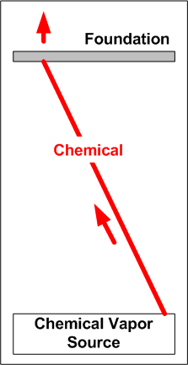
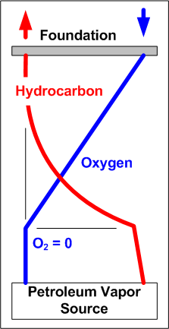
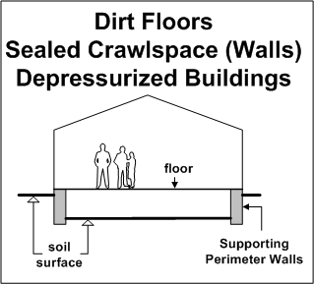
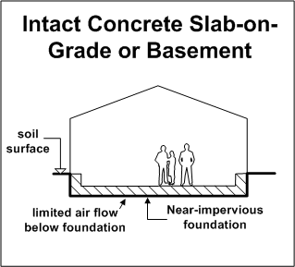
Model Application 3: Extreme Conditions
Potential “worst case” indoor air concentrations
  Building Foundation Types:
  Non-degrading chemicals:
    High Vapor Flow Through Foundation
  Aerobically degrading petroleum:
    Low Oxygen (Air) Flow through Foundation
Key Ideas: “Worst Case” Conditions
Same for or Building, Soils and Vapor Source
Opposite Extreme for Foundation Type
Notes:
This second example is qualitative, and looks at ‘worst case’ conditions.
That is we define reasonable ranges for all the model parameters, then finding the conditions which produces the highest indoor air concentrations.
We’re doing this for ‘non-degrading’ chemicals (PCE, TCE, etc) and aerobically-degrading chemicals like petroleum.
The interesting part is where these two case differ, which is in the worst-case building foundation.
For non-degrading chemicals, worst-case is for foundations which pass the most vapors (low resistance). This would be, typically, a dirt floor, or a dirt floor in a sealed crawlspace.
For degradable chemicals, a worst-case foundation keeps oxygen out of the subsurface (high resistance). This is typically an intact concrete foundation.
So this type of result has implications in site assessment (what types of houses to examine), and, if needed, in mitigation measures.
Figure to start: \\houicvfc006\george.devaull$\Cached\My Documents\VI - paper\Screening Level Development\Shell-Internal\tables and files for review: Figure – bldg.vsd

Slide 19
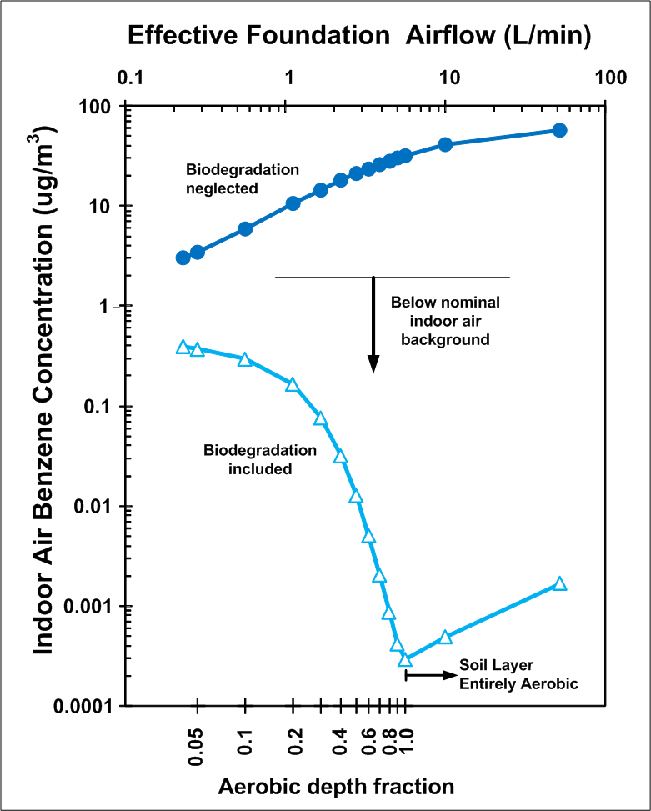
Model Application 4: Sensitivity Analysis
Is a proposed exclusion distance okay for varied buildings?
  Base Case ‘Exclusion Distance’:
    5 ft separation, water-dissolved source
    1 mg/L benzene, 10 mg/L BTEX
    Robin Davis (2010)
  Without Biodegradation
    Higher foundation airflow,
    Higher indoor air concentration
  With Aerobic Biodegradation
    Higher foundation airflow,
    Lower indoor air concentration
    (if oxygen limited)
Model Estimates (BioVapor, www.api.org/vi)
Residential default parameters, varied foundation airflow
Notes:
+ This example application is a variation on the last case.
+ We define a base case consistent with proposed ‘exclusion criteria’
+ Then look at varied foundation conditions to see if the ‘exclusion criteria’ are protective (they are, when biodegradation is included).
+ The illustrated trends (including and neglecting biodegradation) are consistent with the prior slide.
+ Up to the case when oxygen is not limited below the building foundation; at this point the soil layer is entirely aerobic, oxygen is not limited, and a more permeable foundation lets more oxygen into the subsurface, but also more chemical into indoor air.
+ This case also illustrates something that can be done with this modeling; we can make estimates for future land development (buildings that are not yet constructed).
Base Case: 5 ft (152.4 cm) of clean overlying soil; Source strength of 1 mg/L benzene, 10 mg/L dissolved TPH (as 1-3-3-3 BTEX).
Re. Davis (2010); Hartman (2010)
Check effect of 1-D foundation resistance (0.2 L/min to 60 L/min).
Query: Under what conditions will oxygen demand be limiting? [foundation]

Slide 20
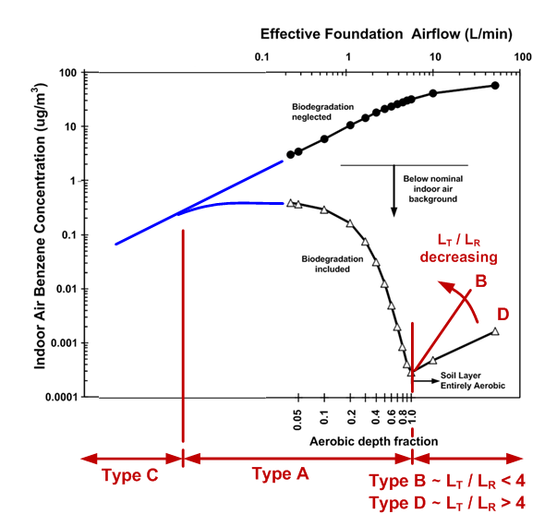
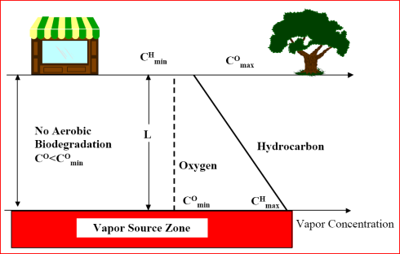
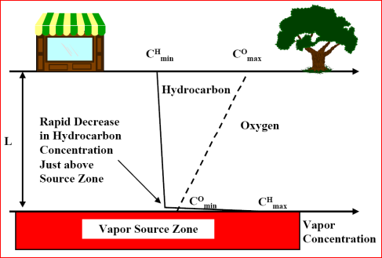
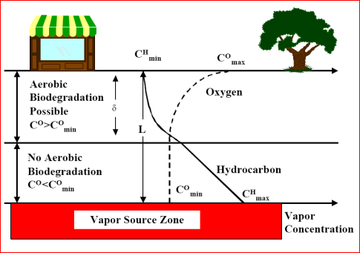
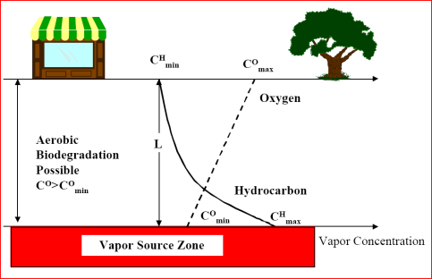
Model Application 4A: Scenario Type Classification
Type C:
Oxygen Deficient
Type D:
Low Diffusion (compared to degradation)
Type A:
(Oxygen) Transport-Limited
Type B:
Biodegradation
Rate - Limited
Profile Type Classes from: Roggemans, et al., 2001: API Soil and Groundwater Research Bulletin No. 15.
Notes:
As a final case example,
+ I’m using the plot from the last case, and adding the four ‘Scenario Types defined by Sophie Roggemans and others in an API Technical Bulletin.
+ In this example, all four of the case types are included through the range of foundation conditions (defined by foundation airflow).
+ Similar plots and an overlay of these types can be put together for sensitivity analyses on other parameters (such as: varied source vapor concentration or varied source-to-foundation separation distance). On which the varied type classes can also be identified.
+ This illustrates that the model is fairly robust; it can estimate a wide range of cases and further it can tie the identified conditions to values or ranges for key parameters.
Roggemans, et al.; Vadose Zone Natural Attenuation Of Hydrocarbon Vapors: An Empirical Assessment Of Soil Gas Vertical Profile Data,
API Soil and Groundwater Research Bulletin Number 15, American Petroleum Institute, December 2001
\\houicvfc006\george.devaull$\Cached\My Documents\VI - paper\AWMA 2010\case examples.vsd <Page> page 13

Slide 21
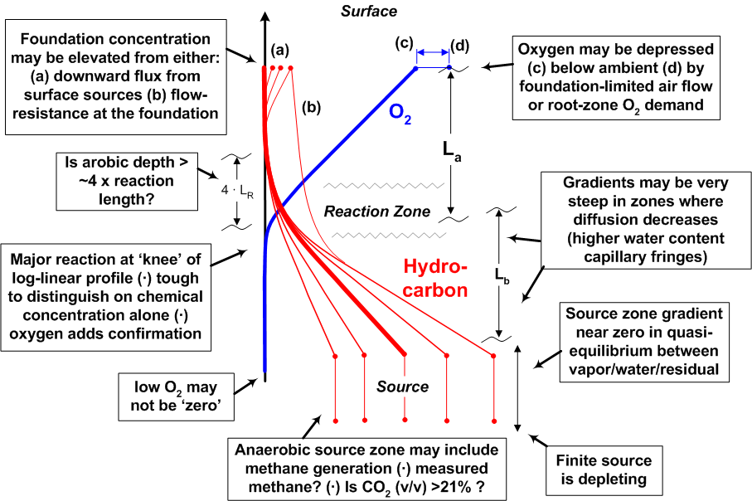
Soil Gas Profile Interpretations
Biodegradation Model helps classify ranges of behavior:

Slide 22
Sensitivity Analysis 1:
BioVapor User’s Guide:
“Some required or optional model inputs parameters such as oxygen concentration below the building foundation and baseline soil oxygen respiration rate are not commonly measured during site investigation. …the user should conduct a sensitivity analysis in order to evaluate the effect of input parameter value uncertainty on the model results”
“Users of this model should not rely exclusively on the information contained in this document. Sound business, scientific, engineering, and safety judgment should be used in employing the information contained herein.”
Neither API nor any….
Weaver, J. (2012). BioVapor Model Evaluation, For 23rd National Tanks Conference Workshop St. Louis, Missouri, March 18, 2012

Slide 23
Sensitivity Analysis 2:
BioVapor versus Johnson and Ettinger:
Parameter importance ranking
  Primary
    Depth, source concentration
    Oxygen content, biodegradation rate, foundation air flow, soil moisture content
  Secondary
    Air exchange rate, other factors in J&E
  Results will be more strongly dependent on source depth and strength than analogous J&E, and unless the source is right below foundation, less dependent on building parameters.
Weaver, J. (2012). BioVapor Model Evaluation, For 23rd National Tanks Conference Workshop St. Louis, Missouri, March 18, 2012.
Picone, S. et al., 2012: Environmental Toxicology and Chemistry, Vol. 31, No. 5, pp. 1042–1052, 2012.

Slide 24
BioVapor Model: Forward Plan
Use:
  Improved Understanding, Oxygen Requirements, Sensitivity
    Baseline Site Screening, Sample Plan Development, Training
    What-if Analysis ( foundation / no foundation, etc.)
    It is .. a model
Review and Plans:
  Validation and sensitivity analysis (EPA OUST, ORD)
  EPA: recoding
  API Workshop: Interactive Demonstration / Case Studies
  Fixes and Updates: Very Few ‘Bugs’ or Model Issues to Date
Notes:
Finally
+ I’ve gone through an introduction for this Biovapor model and shown a few case examples.
+ Currently EPA (Jim Weaver) is looking at a sensitivity analysis of the model; a contractor for EPA has previously validated the math.
+ We have not run the model; API does have a workshop which includes hands-on running through a number of case examples.
+ So far on the first model revision; no significant bugs or model issues have been identified.

Slide 25
American Petroleum Institute BioVapor Model
Download at: www.api.org/pvi
OR Navigate www.api.org to
Environment, Health & Safety > Soil & Groundwater Research > Vapor Intrusion
Free, asks for registration information (update notification)
Questions (API): Roger Claff, claff@api.org, 202-682-8399;
Bruce Bauman, Bauman@api.org, 202-686-8345
Acknowledgements: Tom McHugh, Paul Newberry,
GSI Environmental, Houston.
Notes:
+ The BioVapor model is available from API. It’s a free download.
+ Registration is requested – for communication of updates and a download count.
+ If you have questions, talk to me or contact API staff.
+ And I acknowledge Tom McHugh and Paul Newberry of GSI who put together the software and user guide.
API website updated February 2012. Navigate www.api.org to
Environment, Health & Safety > Soil & Groundwater Research > Vapor Intrusion

Slide 26
Workshop Agenda
Welcome, Introductions, Safety Issues
Update on ITRC VI Workgroup
Update on EPA OUST
BioVapor and other models; and Introduction to Exclusion Criteria
Evaluating the Vapor Intrusion Pathway - Studies
Regulatory updates effecting sampling and Analysis
Case Studies/ Lessons
Summary

Slide 27
State Summary
35 States with Vapor Intrusion Guidance
Screening Values:
media | values | range
indoor air | 0.084 to 4.98 ug/m³ | 140x
groundwater | 2.4 to 3500 ug/L | 1500x
shallow soil gas | 3.1 to 190,000 ug/m³ | 61,000x
Clearly, a lot of variability
Eklund, B., L. Beckley, V. Yates, T. E. McHugh, Overview of State Approaches to Vapor Intrusion, Remediation, Autumn 2012, 7-20.

Slide 28
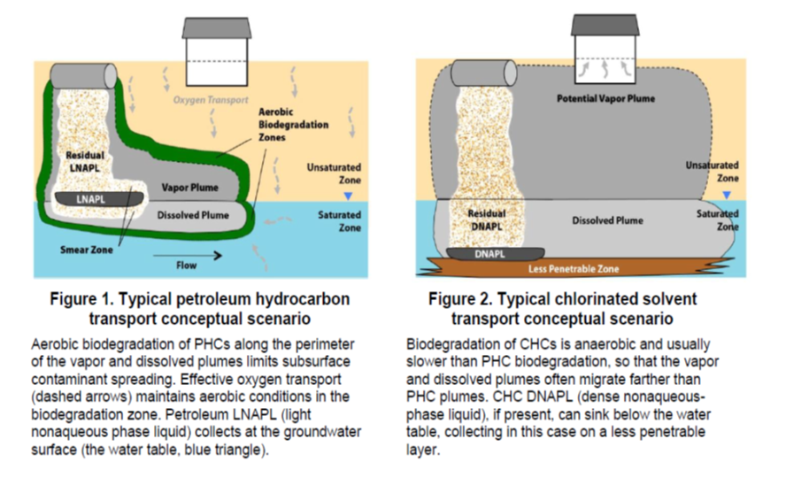
Petroleum Hydrocarbons And Chlorinated Hydrocarbons
Differ In Their Potential For Vapor Intrusion
USEPA OUST 2011http://epa.gov/OUST/cat/pvi/index.htm
Notes:
USEPA OUST is developing a compendium of information about petroleum vapor intrusion (PVI), available at www.epa.gov/oust.
Contact: white.hal@epa.gov or 703-603-7177

Slide 29
Scenario Type Classification
Lower Concentration Source
  Dissolved Groundwater Source
  Clean Soil Model
  Lower VOC flux
  Lower Oxygen Demand
Higher Concentration Source
  LNAPL Source
  Dirty Soil Model
  Higher VOC Flux
  Higher Oxygen Demand
exclusion distance
exclusion distance

Slide 30
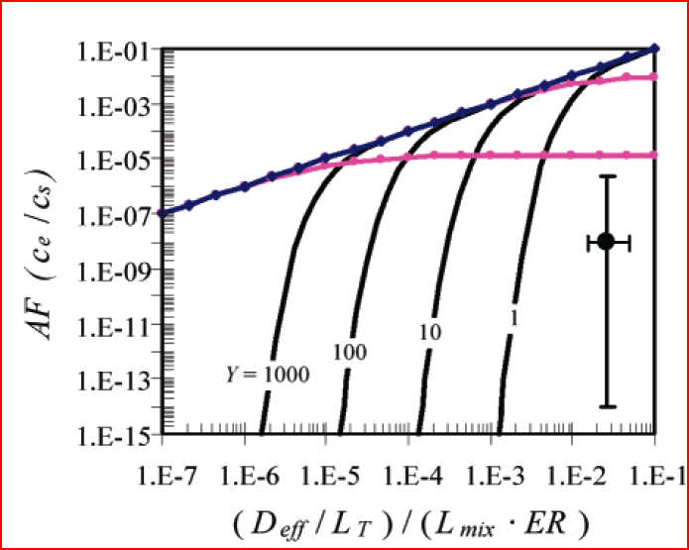
Exclusion Distances
Distance is a much more robust screening factor than an attenuation ratio.
Increase separation distance by a factor of 2, attenuation factor decreases by a factor of 8E-06
DeVaull, G. E., Environ. Sci. Technol. 2007, 41, 3241-3248.

Slide 31
Exclusion distance
Scatter plot – soil gas vs. distance from water table
No detects at all in this quadrant
Low % detect & conc. in this quadrant
Lahvis, M.A., et al., Vapor Intrusion Screening at Petroleum UST Sites, Groundwater Monitoring and Remediation [Article first published online: 21 Feb 2013].
Notes:
Figure 6. Plot of benzene concentrations in soil gas versus distance above a LNAPL hydrocarbon source. Non-detect values are plotted at the reporting limit. The plot includes 467 soil-gas samples collected at 73 UST sites and 204 vertical sampling locations. The cumulative fraction of all (detect and non-detect) benzene soil-gas concentrations is noted on the right vertical axis.

Slide 32
Petroleum Vapor Exclusion Distances
23 states - Range: 5 ft to 100 ft – dissolved phase.
  Eklund, et al. 2012
Site Vapor Database review:
  Dissolved : 0 feet; 5 ft;
  LNAPL: 15 ft
  Lahvis et al., GWMR, online: 21 Feb 2013.
Proposed:
  LNAPL : 15 to 30 feet
  Dissolved phase : somewhat less
  Added factors of conservatism: ???

Slide 33
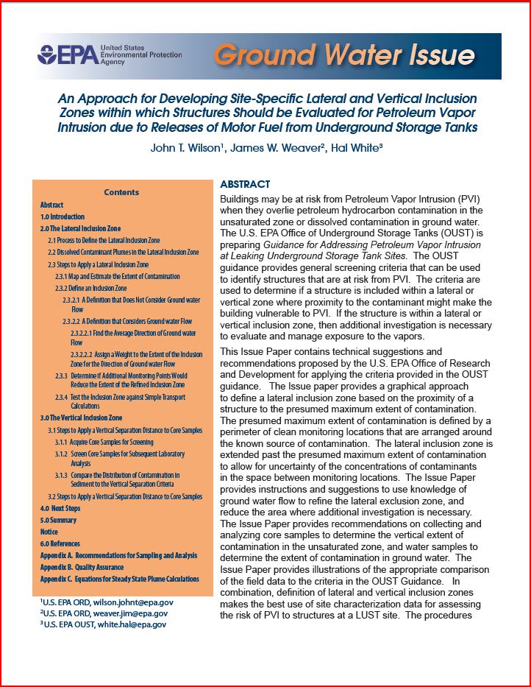
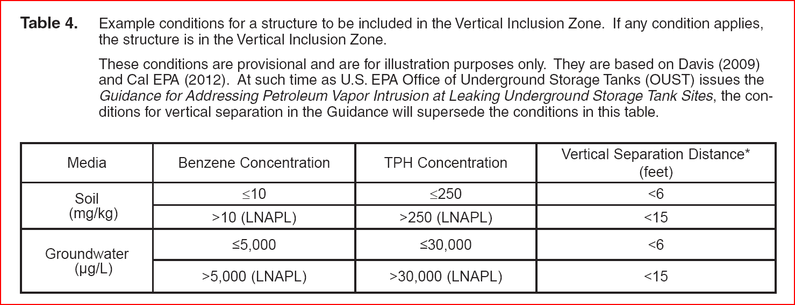
Inclusion Distances
USEPA: An Approach for Developing Site-Specific Lateral and Vertical Inclusion Zones, J. T. Wilson, J. W. Weaver, H. White, National Risk Management Research Laboratory, Cincinnati, OH, EPA/600/R-13/008. December 2012.

Slide 34
Petroleum Vapor Intrusion
USEPA OUST PVI Guidance
  Exclusion distances
  Biodegradation – Modeling
USEPA OSWER VI Guidance
  Not USTs
Each scheduled Nov 2012
  Not too far off …
References:
USEPA, 2013: Evaluation Of Empirical Data To Support Soil Vapor Intrusion Screening Criteria For Petroleum Hydrocarbon Compounds, U.S. Environmental Protection Agency, Office of Underground Storage Tanks, Washington, DC. January. EPA 510-R-13-001.
USEPA, 2012: An Approach for Developing Site-Specific Lateral and Vertical Inclusion Zones, J. T. Wilson, J. W. Weaver, H. White, National Risk Management Research Laboratory, Cincinnati, OH. December. EPA/600/R-13/008.
Lahvis, M.A., et al., Vapor Intrusion Screening at Petroleum UST Sites, Groundwater Monitoring and Remediation [Article first published online: 21 Feb 2013].

Slide 35
End
End

Slide 36
Reserved / retained slides
Some introductory slides follow
Not presented

Slide 37
Basics – Introduction – PVI Overview
To Be Covered:
Conceptual Models
Biodegradation
Building Foundations and Oxygen
Notes:
+ The talk includes:
+ A brief introduction and overview.
+ Several applied examples of the model use.
+ It does not include details of the model theory (which you can find in the model documentation)
+ And does not include running case examples.

Slide 38
Conceptual Model for Vapor Intrusion:
Regulatory Framework
BUILDING
3
Building Attenuation Due to Exchange with Ambient Air
Air
Exchange
Advection and Diffusion Through Unsaturated Soil and Building Foundation
Unsaturated
Soil
2
Affected Soil
Affected GW
Partitioning Between Source and Soil Vapor
Groundwater-Bearing Unit
1
KEY
POINT:
Much of existing regulatory guidance is focused on building impacts due to vapor migration.
Notes:
Slide Topic: Conceptual model for vapor intrusion Diffusion from source and advection into building does not match industry experience.
The standard conceptual model of vapor intrusion has the following key elements:
Partitioning between the source and soil vapors. An infinite source of VOCs is assumed (i.e., no mass flux or mass balance considerations)
Diffusion and advection (but not biodegradation) through unsaturated soils and the building foundation
Attenuation in the building due to exchange with ambient air.
This conceptual model is based on the J&E model.
The U.S. EPA VI guidance was developed using this conceptual model of vapor intrusion.
Slide Presentation: Describe the conventional conceptual model for vapor intrusion.
Key Points:
This conceptual model does not distinguish between petroleum and chlorinated VOCs.
The model assumes an infinite source of VOCs
The model does not account for biodegradation in the vadose zone.
The model does not reflect industry experience with petroleum vapor intrusion impacts (see next slide).

Slide 39
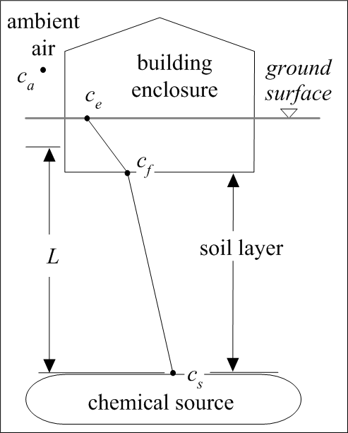
Vapor Flow: Barriers and Limits
Buildings
  Air exchange, positive pressure, background
Building Foundations
  Intact (no cracks or unsealed penetrations)
Vadose Zone
  High soil moisture or clay (no vapor migration)
  Aerobic biodegradation
  Lateral offset
Source and Groundwater
  Clean water lens over source, Clay layers
  Finite source mass, Saturated vapor limits
KEY
POINT:
Presence of subsurface source does not always result in observed vapor intrusion.

Slide 40
Petroleum Hydrocarbons And Chlorinated Hydrocarbons
Differ In Their Potential For Vapor Intrusion
USEPA OUST 2011, www.epa.gov/oust/cat/pvi/pvicvi.pdf
KEY
POINT:
USEPA says that vapor intrusion risk is much lower at petroleum sites.
Notes:
USEPA OUST is developing a compendium of information about petroleum vapor intrusion (PVI), available at www.epa.gov/oust.
Contact: white.hal@epa.gov or 703-603-7177

Slide 41
Basics – Introduction - PVI
To Be Covered:
Conceptual Models
Biodegradation
Building Foundations and Oxygen
Notes:
+ The talk includes:
+ A brief introduction and overview.
+ Several applied examples of the model use.
+ It does not include details of the model theory (which you can find in the model documentation)
+ And does not include running case examples.

Slide 42
Petroleum VI - Biodegradation
Biodegradation … is significant
  Regulation & guidance:
US EPA. 2002.
US EPA. 2005. EPA/600/R-05/106.
ITRC. 2007.
US EPA. 2011.
Others …
Notes:
US EPA. 2002. Draft Guidance for Evaluating the Vapor Intrusion to Indoor Air Pathway from Groundwater and Soils (Subsurface Vapor Intrusion Guidance). EPA/530/D-02/004, U.S. Environmental Protection Agency Office of Research and Development, Washington, DC, Washington, D.C., November, 2002: pp. 52.
Tillman, F.D., and J.W. Weaver. 2005. Review of recent research on vapor intrusion. EPA/600/R-05/106, U. S. Environmental Protection Agency Office of Research and Development, Washington, DC, September, 2005: pp. 41.
ITRC. 2007. Vapor intrusion: A practical guideline. Interstate Technology & Regulatory Council, Washington, D.C., January, 2007: pp. 74.
US EPA. 2011. Petroleum Hydrocarbons And Chlorinated Hydrocarbons Differ In Their Potential For Vapor Intrusion. United States Environmental Protection Agency, Washington, D.C., September, 2011: pp. 13.

Slide 43
Biodegradation of Petroleum Chemicals
In 100+ years of publications:
Observations:
  Fast acclimation times
    absent other limits, by:
      population enrichment (fast biomass growth)
      and/or plasmid transfer
      acclimation times can be affected by prior exposure
  Environmental Conditions:
    0°< to 70°C
    salinity up to 25% NaCl
    pH from 6 to 10
    optimum conditions can be narrower
  Redox Conditions
    Aerobic
      equally good in range from 0.5 to 30 mg/L aqueous dissolved oxygen
    Anaerobic
      observed, not ubiquitous
      other electron acceptors present (nitrate, sulfate, etc.) [strict or facilitative], or
      including fermentive / methanogenic conditions
Biodegradation Reported for:
  solid, liquid, gases (methane & up)
  straight, branched, ring(s), C-, C=;
  by many species, 30+ genera bacteria, 25+ genera fungi, algae
    not every chemical degraded by every species
  marine, freshwater, sediments, soils
  in direct metabolism and co-metabolism (co-oxidation)
  Producing
    Biomass
    intermediate products (alcohols, aldehydes, organic acids)
    ultimate mineral products: CO₂, H₂O
Reviews of petroleum biodegradation:
Zobell, C. E., Bacteriological Reviews, 1946, 10(1-2): 1–49. 182 refs.
Atlas, R. M., Microbiological Reviews, 1981, 180-209. 305 refs.
Leahy, J. G.; Colwell, R. R., Microbiological Reviews, 1990, 305-315. 157 refs.

Slide 44
Observed Soil Gas Profiles
Lower Concentration Source
  Dissolved Groundwater Source
  Clean Soil Model
  Lower VOC flux
  Lower Oxygen Demand
Higher Concentration Source
  LNAPL Source
  Dirty Soil Model
  Higher VOC Flux
  Higher Oxygen Demand

Slide 45

Aerobic Biodegradation in Soils: Factors
Food (Substrate)
Energy for growth and maintenance
Bioavailable (water-phase) •
Transport
Through bulk soil matrix
Diffusion within soil matrix (at and below scale of soil particles) •
Between chemical phases (water, soil gas, sorbed, LNAPL)
Biomass
Concentration
Species diversity
History (Acclimation)
Food to Biomass Ratio •
Nutrients
Oxygen
Presence •
Inhibition
Absence of Moisture •
Toxic Intermediate Compounds

Slide 46
Exponential Decay: Data Analysis & Scaling
Simple solutions (exponential decay) apply in some simplified geometries
Other solutions (algebraic, numerical) also used.
Published and available rates defined or re-defined in terms of k_{w}.
time
space
θ_{w} - soil moisture; k_{w} - first-order water phase rate; D_{eff} - effective diffusion coefficient, H - Henry’s law coefficient; R - soil/vapor partition
other conditions similar: aerobic throughout
Notes:
Slide illustrates simplified solutions in transport equation (two common cases – space and time).
Microcosm rate includes partitioning between chemical in water to total chemical mass.
In microcosms, more volatile (in air phase) or sequestered (in oil phase) chemicals show slower observed decay, sometimes at very slow rates.
Spatial rate includes a diffusion rate relative to a degradation rate.

Slide 47
Results: Aerobic Petroleum Biodegradation Rates in Soil
Aromatic Hydrocarbons
k_{w} = 0.48 /hr (0.08 to 3.0)
k_{w} = 40 /hr (7.8 to 205)
Aliphatic Hydrocarbons
Notes:
Skewed (lognormal) distribution of data.
Similar results for BTEX (means, median).
More scatter for naphthalene (but lower Henry’s law than BTEX).
Maybe faster for cumene (which is more aliphatic-like): isopropylbenzene, or just limited data.
Figure: rate figure.vsd <Page 6>
Consolidated from data:

Slide 48
Data Sources: references
Field Data, Diffusive and Advective Columns, Batch Microcosms
Field studies
1. Christophersen, M., et al., J. Contaminant Hydrogeology, 2005, 81, 1-33.
2. Fischer, M. L., et al., Environ. Sci. Technol., 1996, 30, 10, 2948–2957.
3. Hers, I., et al., J. Contaminant Hydrology, 2000, 46, 233-264.
4. Höhener, P., et al., J. Contaminant Hydrology, 2006, 88, 337-358.
5. Lahvis, M. A., et al., Water Resources Research, 1999, 35, 3, 753-765.
6. Lundegard, P. D., et al., Environ. Sci. Technol., 2008, Web 07/03/2008.
Diffusive soil columns and lysimeters
7. Andersen, R. G., et al., Environ. Sci. Technol., 2008, 42, 2575–2581.
8. DeVaull, G. E., et al., Shell Oil Company, Houston. 1997.
9. Höhener, P., C. et al, J. Contaminant Hydrology, 2003, 66, 93-115.
10. Jin, Y., T. et al., J. of Contaminant Hydrology, 1994, 17, 111-127.
11. Pasteris, G., et al., Environ. Sci. Technol., 2002, 36, 30-39.
Advective columns
12. Salanitro, J. P., M. M. Western, Shell Development Company, Houston. 1990, TPR WRC 301-89.
13. Moyer, E. E., PhD Thesis, University of Massachusetts, 1993.
14. Moyer, E. E., et al., in In Situ Aeration: Air Sparging, Bioventing, and Related Remediation Processes, R. E. Hinchee, et al, eds., (Battelle Press, Columbus), 1995.
Microcosm studies
15. Chanton, J., et al., at: PERF Hydrocarbon Vapor Workshop, January 28-29, 2004. Brea, CA.
16. Einola, J. M., et al., Soil Biology & Biochemistry, 2007, 39, 1156–1164.
17. Fischer, M. L., et al., Environ. Sci. Technol., 1996, 30 (10), pp 2948–2957.
18. Holman, H. Y.; Tsang, Y. W., in In Situ Aeration: Air Sparging, Bioventing, and Related Bioremediation Processes, R. E. Hinchee, et al, eds., (Battelle Press, Columbus), 1995, 323-332.
19. Ostendorf, D. W., et al., Environ. Sci. Technol. 2007, 41, 2343-2349.
20. Salanitro, J. P., Western, M. M., Shell Development Company, Houston, 1988, TPR WRC 161-88.
21. Salanitro, J. P; Williams, M. P.; Shell Development Company, Houston, 1993, WTC RAB 4-93.
22. Scheutz, C. et al., J. Environ. Qual. 2004, 33:61-71.
23. Toccalino, P. L., et al., Applied and Environmental Microbiology, Sept. 1993, 2977-2983.
Notes:
references

Slide 49
Constraints on Kinetic Data and Application
Tabulated Rates Okay for Most Vadose Zone Soils
Maybe Not: Near active vapor pumping points, capillary fringe, water-saturated soils, high NAPL loading. Due to:
  Potential non-equilibrium local soil partitioning, or
  Diffusion-limited biological reaction
Notes:
Cartoon on where the data evaluation is applicable.
Low advective velocity (for equilibruim phase partitioning). Low Pe = ( U · L / Deff ) = velocity · length / diffusion
And adequate diffusion rate (see next).
Figure Diffusion Coefficients <Page-2>

Slide 50
Petroleum Chemical Phase Partitioning in Soil
Notes:
Phase partitioning diagram. Phase volumes shown are typical for vadose zone soil, no residual oil in soil, low organic carbon in soil
Discussion:
A diagram similar to the one applied here is shown in an equilibrium compartment model presented by Gouin et al, 2000, and Foster et al., 2005, for a mesoscale volume of soil, air, and water. Octanol is a surrogate for organic carbon in soil and sediments.
I’ve used the same diagram, but applied it for a soil matrix, typical of moist, vadose zone soils.
Soil Matrix:
porosity = 0.425 mL-void/mL-soil
Moisture = 0.13 mL-water/mL-soil
foc = 0.005 g/g
Data is plotted for light petroleum chemicals, normal boiling point less than 225°C.
Henry’s law coefficient (air-water partitioning) is approximately 1.5 to 3 orders of magnitude less for aromatics than aliphatics.
References:
Foster, K. L.; Mackay, D.; Parkerton, T. F.; Webster, E.; Milford, L.; Five-Stage Environmental Exposure Assessment Strategy for Mixtures: Gasoline as a Case Study, Environ, Sci. Technol., 2005, 39, 2711-2718.
Gouin, T.; Mackay, D.; Webster, E.; Wania, F.; Screening Chemicals for Persistence in the Environment, Environ, Sci. Technol., 2000, 34, 881-884.
Figure: Partitioning diagram.vsd <page 4>
Calculation: My Documents\Fuel Chemicals\gw-models-notes\Compartment Models\partition v4 - oil only.xls

Slide 51
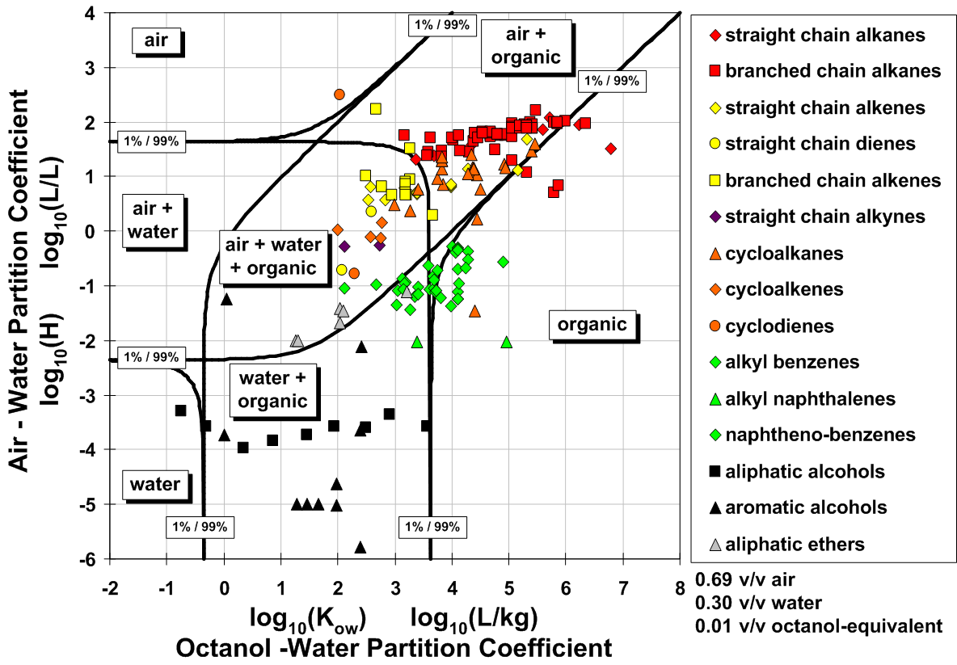
… and alcohols

Slide 52
Basics – Introduction - PVI
To Be Covered:
Conceptual Models
Biodegradation
Building Foundations and Oxygen
Notes:
+ The talk includes:
+ A brief introduction and overview.
+ Several applied examples of the model use.
+ It does not include details of the model theory (which you can find in the model documentation)
+ And does not include running case examples.

Slide 53
Oxygen Under Building Foundation
Key Question:
n Is there enough oxygen below building foundations to support aerobic biodegradation?
aerobic zone
C_{t}
anaerobic zone
C_{s}
Vapor Source

Slide 54
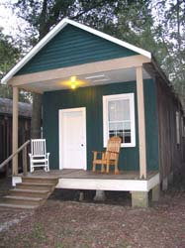
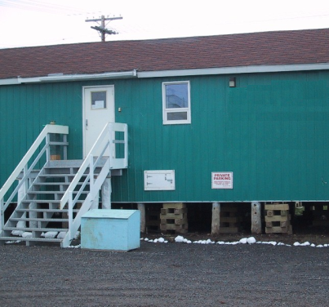
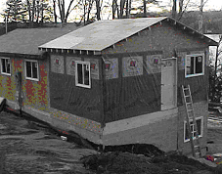
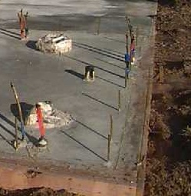
Building Foundation Types and Air Flow
“Open / breezy” foundation: high airflow
Raised buildings: on stilts, piles, piers:
  Due to unstable soils, wet soils (expansive clays, muskeg, bogs, swamps) or climate (air circulation, termites, flooding).
“Airtight” Foundations - limited airflow:
Slab-on-grade. Basements.
Crawlspaces.
  Edge walls depth: frost heave
  Influenced by capillary break or vapor barriers [moisture control]
Buildings may be “airtight” or “open / breezy” depending on soils.
Suggestion: If unknown, choose nominal “worst case” for the area.
Notes:
Building foundations and construction techniques vary considerably, as do descriptions. Pictures help.
Buildings with relatively impermeable surfaces in contact with the soil surface may have restricted airflow below the building foundation These can be poured concrete, concrete block, or stone foundations. [basements, slab-on grade, some crawlspaces with concrete floors]. There is still airflow under the foundation, driven by indoor/outdoor temperature differences, and wind generated pressure differences between indoors and outdoors. There are penetrations through foundations, either as cracks or intended openings for utilities. In this case oxygen concentration right below the foundation may be less than ambient. In the biodegradation model application to be discussed, oxygen is constrained to [1] less than or equal to ambient oxygen concentrations in the atmosphere and [2] less than or equal to the mass flux of oxygen available from convective airflow through and under the foundation.
Some buildings have relatively open airflow below the foundation, and below the occupied living space. These spaces may be open (as in the included pictures), or closed (with skirting covering the opening between the building floor and the ground surface) [pier, piles, stilt foundations]. If the soil surface is open, oxygen concentrations in air and at the soil surface are equal to ambient concentrations. In these cases the airflow (and oxygen flow) into the soil can be considered relatively non-restricted. In biodegradation model application, oxygen at the soil surface is equal to atmospheric oxygen levels. No restriction on oxygen flux into the soil is imposed.
If the building construction is unknown, we presume restricted airflow, which is more conservative (over estimating exposure) for the biodegradation scenarios.
In addition to foundation construction, buildings may be “airtight”, that is with more restricted indoor/outdoor airflow, in severe or cold climates, or where mechanical heating and cooling systems are used. “Open/ breezy” buildings are more common in moderate and tropical climates.
A special note: For commercial or high rise residential buildings with basement parking garages, the required ventilation for potential carbon monoxide issues in the parking areas can also be sufficient to address potential for subsurface vapor intrusion issues.

Slide 55
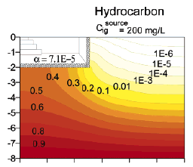
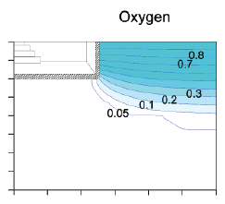
Oxygen Under Foundation: Model Prediction
Numerical model predicts oxygen shadow below building, but…..
Very strong vapor source
(200,000,000 ug/m³)
All flow into building is through perimeter crack
No advective flow directly below building
This model does not account for key oxygen transport processes.
KEY
POINT:
From Abreu and Johnson, ES&T, 2006, Vol. 40, pp 2304 to 2315

Slide 56
Aerobic Biodegradation: Mass Balance
microbes
Hydrocarbon + Oxygen
Carbon Dioxide + Water
1 kg C_{x}H_{y} + 3 kg O₂
3.4 kg CO₂ + 0.7 kg H₂O
21% oxygen ( = 275 g/m³)
Provides capacity to degrade 92 g/m³ hydrocarbon vapors
KEY POINT:
Even limited migration of oxygen into subsurface will support significant aerobic biodegradation.

Slide 57
Transport of Oxygen Under Foundation
  Wind Driven Advection
    lateral pressure upwind / downwind
  Bi-Directional Pressure Flow Across Foundation (back and forth)
    Time-dependent pressure fluctuations
    Indoor VOCs detected in sub-slab samples (McHugh)
  Indoor-Subsurface Pressure gradient (steady)
    Mean flow volume balance (out = in)
  Oxygen Diffusion through Concrete (Large Area)
    Measured diffusion rates are not zero
Notes:
alpha pinene
- limonene
- p-dichlorobenzene

Slide 58
time-dependent pressure
Back-and-forth:
  air flow follows pressure gradient
  warm days and cold nights
    Induced: Furnace cycling
    Direct: Temperature differences, wind
  Varies with building & season

Slide 59
Oxygen Blow Buildings
  Summary:
  Even modest oxygen transport yields sufficient aerobic biodegradation in most cases
  Oxygen demand (from high hydrocarbon source) can deplete oxygen below building foundations and capping layers.
  Very Large Buildings ?
    Refinery site: Perth, Australia (Patterson and Davis, 2009)
    Measured Depleted Oxygen below Building Center
    35 to 40 g/m³ hydrocarbon vapor above LNAPL at 10 feet depth
  Two key factors – both needed:
    Limited oxygen transport below the foundation &
    High oxygen demand

Slide 60
Conclusion: Introduction Overview
Subsurface source to indoor air vapor intrusion
Actual Issues: Petroleum VI
Occur very infrequently
Occur (sometimes) with:
  Very large releases of petroleum to the subsurface
  Petroleum LNAPL very close, in contact with, or inside a basement or utility connected to an enclosure

