Slide 1
Disney Cruise Line
Environmental Initiatives

Slide 2
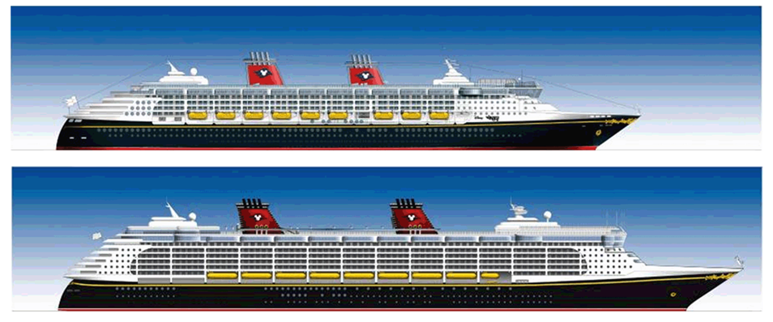
Magic / Wonder
Dream / Fantasy
Magic/Wonder Dream/Fantasy
TONNAGE
STATEROOMS
LENGTH
DECKS
CREW COUNT
GUEST COUNT
83,000 128,000
877 1,250
964.5ft 1,115.5ft +/-
11 14
950 1450
2,713 4,000
Notes:
Gross tonnage: 83,000 vs 128,000
Guest Count: went from 2713 – 4000 (47%)
Room Count 877 – 1250
Crew from just shy of 1000 to just shy of 1500 – very high crew to guest ratio
from over 8000 to over 17,000 passengers a week

Slide 3
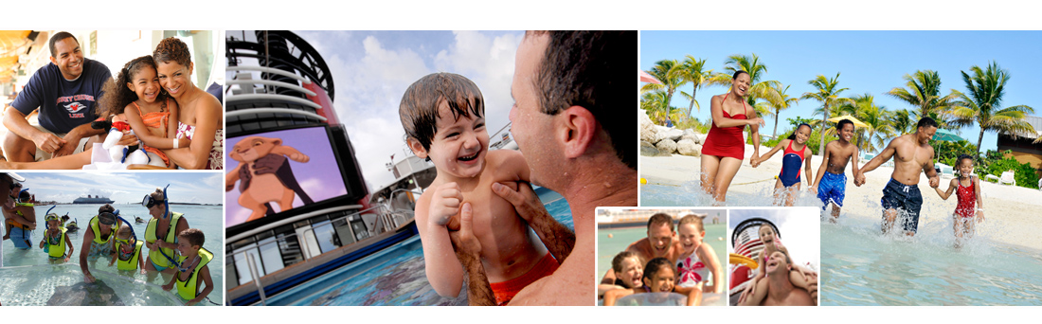
families
Ships and experiences designed with in mind.
Disney Cruise Line emphasizes multi-generational experiences with something for everyone

Slide 4
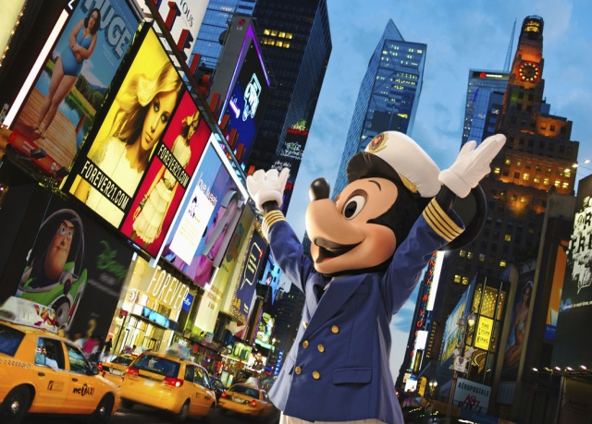
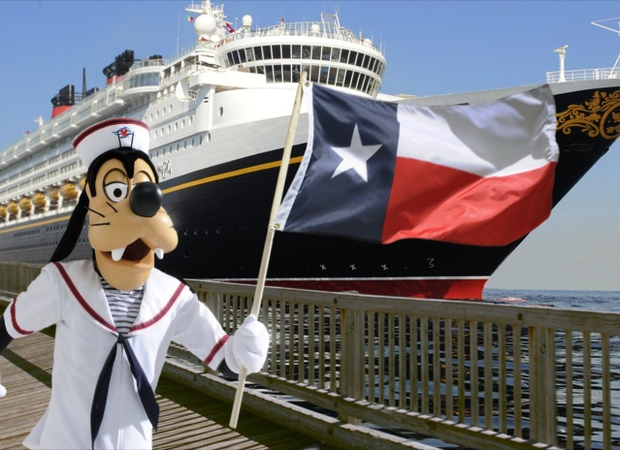
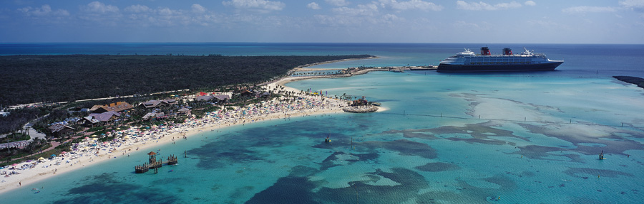
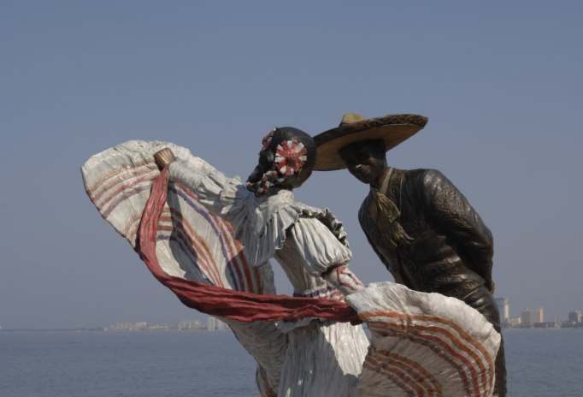
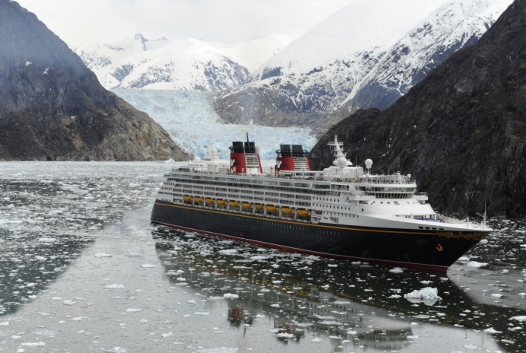
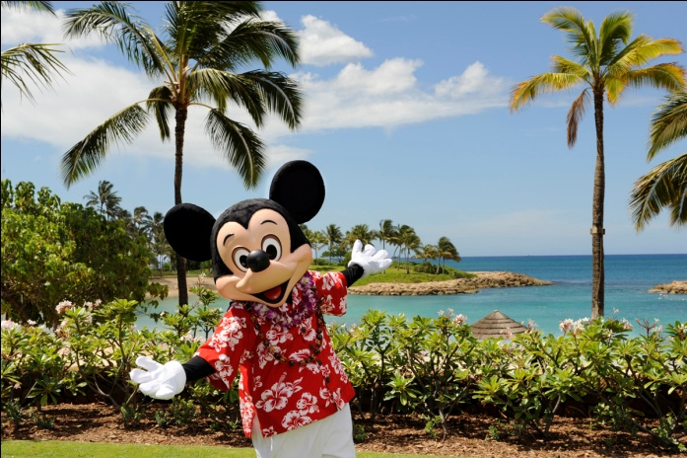
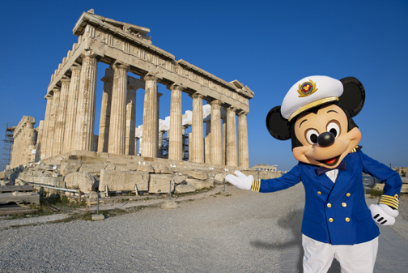
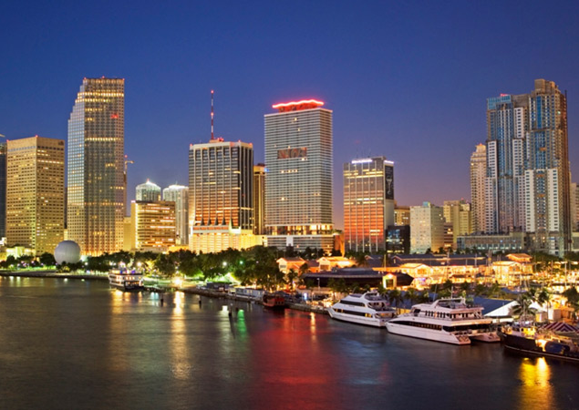
New York
Galveston
Castaway Cay
Mexican Riviera
Alaska
Hawai‘i
Ports & Itineraries
Greece
Miami

Slide 5

Environmental Goals
Committed to being responsible stewards of the environment
Reduce energy use
Reduce waste
Net positive impact on ecosystems
Minimize water use
Minimize environmental footprint
Inform, empower and activate employees, business partners, and consumers to take positive action for the environment
Notes:
5

Slide 6
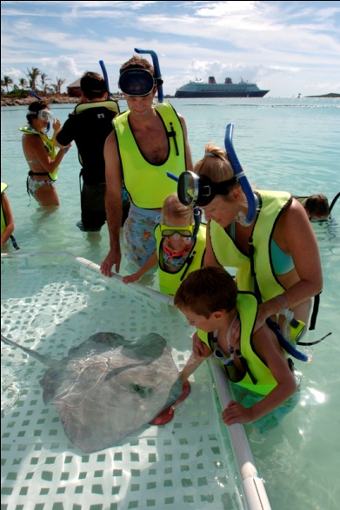

Guest Awareness
Environmental Messaging
  Stingrays and Sea Urchins
  Onboard Environmental Video
Conservation
  Towel use advisory in Staterooms
  Water use
  Disney Worldwide Conservation Fund
Onboard Programs
  Partner with US Forest Service in Alaska
  Youth Activities

Slide 7
Community Outreach
Annual Beach Cleanup
Disney’s Conservation Challenge
Coral Reef transplants
Partner with education groups in Ports of Call
Material donations to schools and merchants in Ports of Call

Slide 8




Leadership
Actively influence industry
environmental policy through
  CLIA
  NWCCA
  ECC
Strong partnerships
  EPA
  U.S. Coast Guard
  State agencies

Slide 9
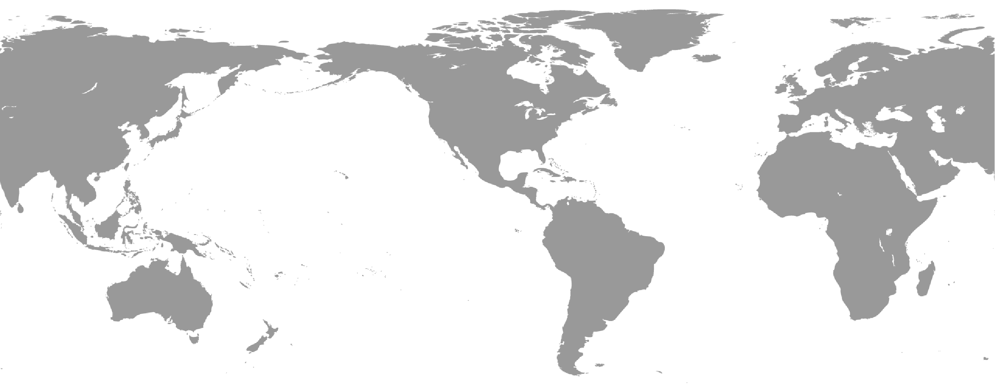


Walt Disney Parks and Resorts Integrated Environmental Team

Slide 10
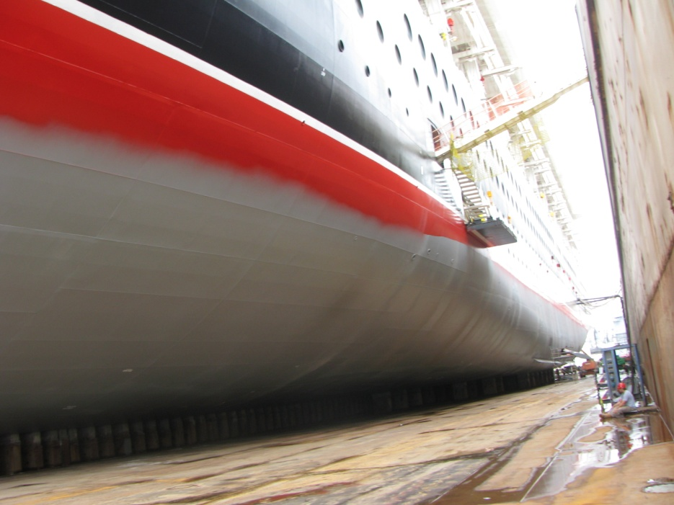
Energy Management Programs
Shore Power
Hull Coating
Itinerary timing and speed changes to maximize fuel efficiency
Onboard energy management systems
Offsets

Slide 11

Desired Emissions Portfolio
Balanced Approach
Offsets
Power Generation from cleaner sources
Reduce consumption
Notes:
Reduce consumption through behavior and technology speaking points:
Emission policy; culture change; fuel efficiency in ships; bus replacement
Cold-ironing for ships

Slide 12
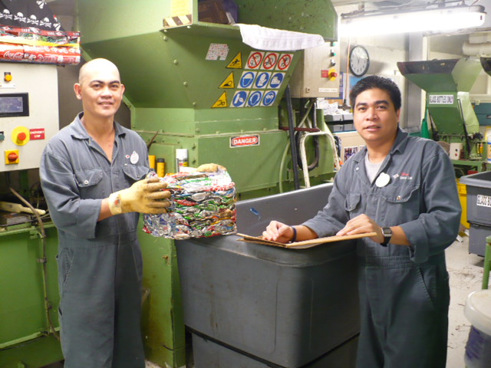
Waste Management
All garbage is sorted
Recycling - Cardboard, Paper,
Glass, Steel and Aluminum,
lead-acid batteries and
Used Cooking Oil
Return To Vendor when possible (pyrotechnics, medications)
Reduction Strategies
(less paper, less plastic)

Slide 13
Water Conservation
Minimize water use
  Use air conditioning condensate for deck cleaning
  High efficiency laundry washing machines
  Low volume shower heads and toilets

Slide 14
Crew Awareness
Mandatory environmental training
Environmental education (water and energy reduction initiatives)
Environmental awards
Participation in community environmental outreach
Monthly shore Environmental Committee linking to ship Environmental Committees

Slide 15
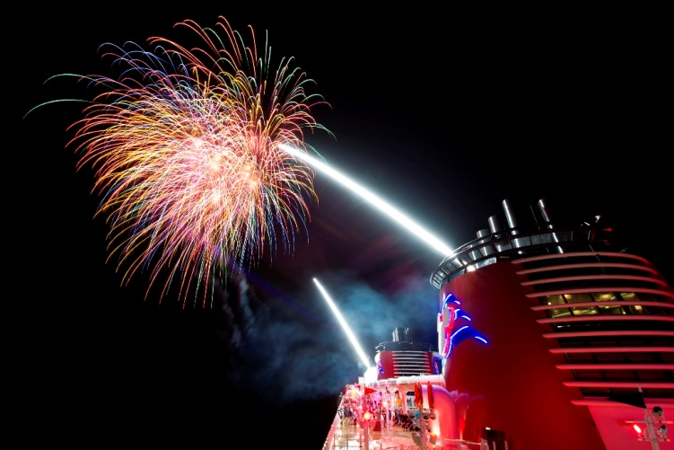
Other Key Initiatives
Advanced wastewater purification systems
Onboard chemical management system
Bulk condiment stations
Constantly exploring new technologies
  Scrubbers
  Alternative fuels
Mammal avoidance programs
Opacity monitoring
Food-based fireworks

Slide 16
Thank You!
Patrick Gerrity
Disney Cruise Line

