Slide 1


API Pipeline SMS Contractor Assessment Program
Aligned with API RP 1173, Pipeline Safety Management Systems
Notes:
In 2020, API launched the Operator-focused Pipeline Safety Management System (SMS) Assessment Program, an out of the box solution to help companies implement API 1173. Through implementation efforts in the operator community, it became clear that industry could better support the contractor community to align our efforts across the pipeline segment.
In 2022, API and the PSMS Industry Team published Pipeline SMS: A Contractor’s Guide to help align industry around specific RP 1173 Requirements (56) that are prime for consideration by the pipeline contractor/service provider community.

Slide 2

Opportunity
The role of contractors in a Pipeline SMS deserves a dedicated third-party assessment option to assist in their journey.
Historically, a third-party assessment offering exists for pipeline operators. As industry continues to mature, the importance of providing contractors with access to an independent third-party assessment and tools will only improve safety progress towards the industry goal of zero incidents.

Slide 3





Executive Summary
This contractor third-party assessment is intended to assist all contractors, regardless of size and scope, to help achieve pipeline safety improvements through professional feedback on their Company’s Pipeline Safety Management efforts. This Program offers three (3) different service offerings designed to support the needs of contractors.

Slide 4




Rules of Engagement
Not a check the box audit, but a not-for-profit collaborative effort focused on the 56 statements identified by industry as applicable for contractors.
Contractors work directly with API and own all reporting associated with their assessment(s). All outputs or sharing of results is at contractor’s sole discretion.
Diverse pool of Assessors, including former contractors, operators, and regulators provide action-based feedback.

Slide 5
Offering Summary
Offering 1 – Guided Gap Assessment
Offering 2 – Focused Assessment
Offering 3 – Full Assessment
Contractor Prep Time: Low
Virtual Only
Personalized Learning Sessions (QA/QC on self-assessment tools) including Q&A
Verbal report out using a pptx and bulleted observations & discussion points for Company on completed assessment
Contractor Prep Time: Medium
On-site optional (Daily Rate/Travel)
Assessment Plan and Document Review of predefined PSMS pick list of elements within 56 requirement statements
Verbal report out with delivery of (1) PPTX assessment report for each selected element area(s)
Peer Support (post-assessment)
Contractor Prep Time: High
On-site included
Review of company provided policies and procedures for full gap analysis of all 56 requirement statements
Field verification and analysis by assessor(s) may be added for additional cost
Maturity evaluation that aligns with the industry accepted PSMS maturity model
Benchmarking

Slide 6


Contractor Journey Roadmap EXAMPLE
Planning
Developing
Implemented
Sustaining
Are you starting?
Are you developing it?
Did you develop it?
How is it helping?
Learn from Others
Offering 2- Focused Assessment on areas for improvement
Offering 3 – Repeated Assessments
Industry events
✓
✓
Industry Guidance
Offering 1 – Guided Gap Assessment
✓
Offering 3- First Full Assessment
Self Assessment Tool
✓
Internal Implementation
PipelineSMS.org resources
✓
Improve your programs and close gaps

Slide 7
Price Table
Guided Gap Assessment
Focused Assessment
Full Assessment
Price: $2,000
~4 Hours - (2) Two Hour Sessions
(Virtual Only)
Price: $3k-5k
Varies Upon Selection
On-site option with + Daily Rate/Travel
Price: $10k-13k
2.5 Days + Reviews
In-Person Assessment
Contractor Prep Time | Low | Medium | High (<15 hours)
Deliverable
Assessor Feedback | ✓ | ✓ | ✓
Verbal Report | ✓ | ✓ | ✓
Written Report | PPTX | PPTX | ✓
Executive Summary (2 pg) | X | X | ✓
Office Visit (in person) | X | (optional) | ✓
Field Verification | X | X | (optional)
Benchmarking | X | X | ✓

Slide 8
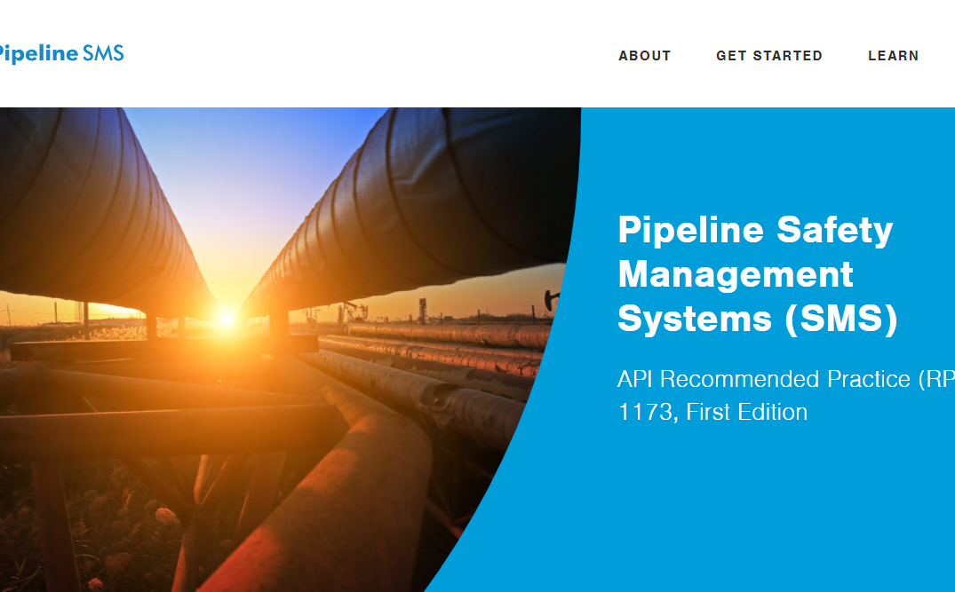
Contact Us
Email: PipelineSMS@api.org
Website: pipelinesms.org

Slide 9

This presentation made in partnership with Lolalink

